Slide 1
Criss-crossing
My idea!

Slide 2





x
$$B (10,6)$$
Criss-crossing
x
x
$$A (−2,2)$$
$$C (14,−26)$$
x
$$D (1,−4)$$
You are given the coordinates of four points.
Please follow the following instructions:
Find the equation of the line through $A$ and $B$, label it $L_{1}$.
Find the equation of the line through $C$ that is perpendicular to $L_{1}$, label it $L_{2}$.
Find the equation of the line through $D$ that is perpendicular to $L_{2}$, label it $L_{3}$.
Find the equation of the line through $A$ that is perpendicular to $L_{3}$, label it $L_{4}$.
The four lines intersect to form a rectangle. What is its area?
(not to scale)

Slide 3




x
$$B (10,6)$$
Criss-crossing
$$L_{1}$$
x
x
$$A (−2,2)$$
$$C (14,−26)$$
x
$$L_{3}$$
$$D (1,−4)$$
You are given the coordinates of four points.
Please follow the following instructions:
Find the equation of the line through $A$ and $B$, label it $L_{1}$.
Find the equation of the line through $C$ that is perpendicular to $L_{1}$, label it $L_{2}$.
Find the equation of the line through $D$ that is perpendicular to $L_{2}$, label it $L_{3}$.
Find the equation of the line through $A$ that is perpendicular to $L_{3}$, label it $L_{4}$.
The four lines intersect to form a rectangle. What is its area?
$$L_{2}$$
$$L_{4}$$
(not to scale)

Slide 4
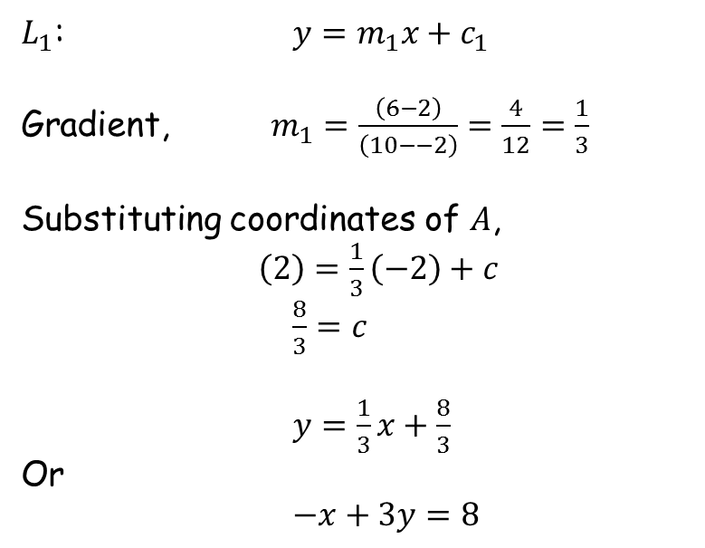
Criss-crossing
x
$$B (10,6)$$
$L_{1}$: $y=m_{1}x+c_{1}$
Gradient, $m_{1}=\frac{\left(6−2\right)}{\left(10−−2\right)}=\frac{4}{12}=\frac{1}{3}$
Substituting coordinates of $A$,
$\left(2\right)=\frac{1}{3}\left(−2\right)+c$
$\frac{8}{3}=c$
$y=\frac{1}{3}x+\frac{8}{3}$
Or
$−x+3y=8$
$$L_{1}$$
x
x
$$A (−2,2)$$
$$C (14,−26)$$
x
$$L_{3}$$
$$D (1,−4)$$
$$L_{2}$$
$$L_{4}$$
(not to scale)

Slide 5
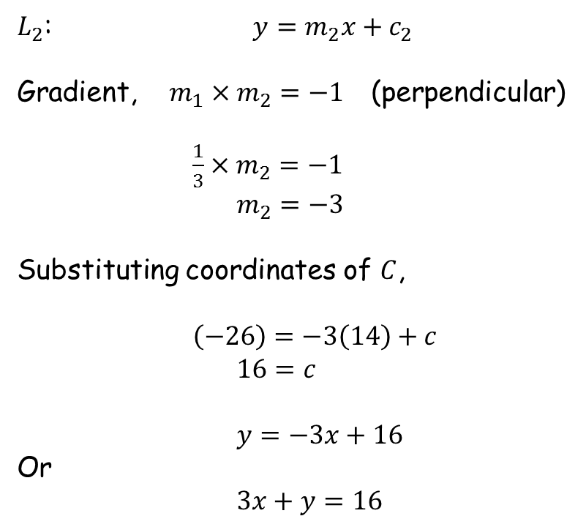
Criss-crossing
x
$$B (10,6)$$
$L_{2}$: $y=m_{2}x+c_{2}$
Gradient, $m_{1}×m_{2}=−1$ (perpendicular)
$\frac{1}{3}×m_{2}=−1$
$m_{2}=−3$
Substituting coordinates of $C$,
$\left(−26\right)=−3\left(14\right)+c$
$16=c$
$y=−3x+16$
Or
$3x+y=16$
$$L_{1}$$
x
x
$$A (−2,2)$$
$$C (14,−26)$$
x
$$L_{3}$$
$$D (1,−4)$$
$$L_{2}$$
$$L_{4}$$
(not to scale)

Slide 6
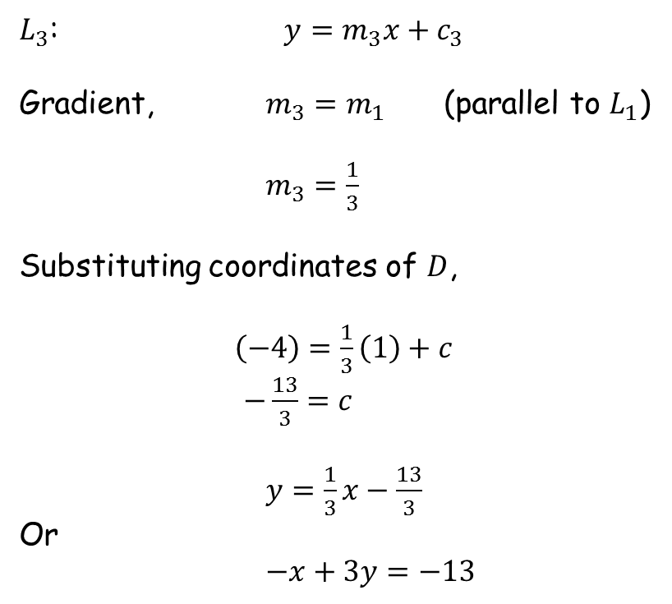
Criss-crossing
x
$$B (10,6)$$
$L_{3}$: $y=m_{3}x+c_{3}$
Gradient, $m_{3}=m_{1}$ (parallel to $L_{1}$)
$m_{3}=\frac{1}{3}$
Substituting coordinates of $D$,
$\left(−4\right)=\frac{1}{3}\left(1\right)+c$
$−\frac{13}{3}=c$
$y=\frac{1}{3}x−\frac{13}{3}$
Or
$−x+3y=−13$
$$L_{1}$$
x
x
$$A (−2,2)$$
$$C (14,−26)$$
x
$$L_{3}$$
$$D (1,−4)$$
$$L_{2}$$
$$L_{4}$$
(not to scale)

Slide 7
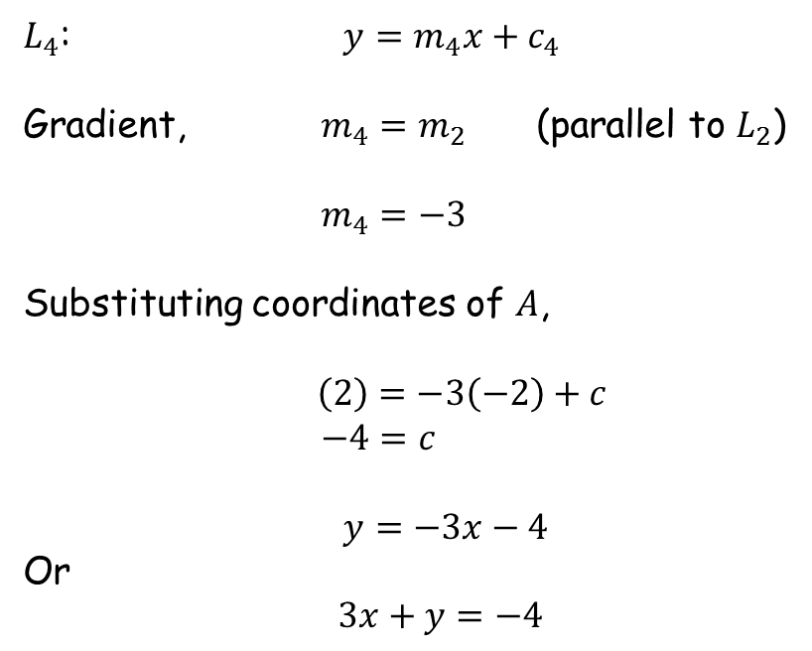
Criss-crossing
x
$$B (10,6)$$
$L_{4}$: $y=m_{4}x+c_{4}$
Gradient, $m_{4}=m_{2}$ (parallel to $L_{2}$)
$m_{4}=−3$
Substituting coordinates of $A$,
$\left(2\right)=−3\left(−2\right)+c$
$−4=c$
$y=−3x−4$
Or
$3x+y=−4$
$$L_{1}$$
x
x
$$A (−2,2)$$
$$C (14,−26)$$
x
$$L_{3}$$
$$D (1,−4)$$
$$L_{2}$$
$$L_{4}$$
(not to scale)

Slide 8

Criss-crossing
$$L_{1}$$
Summarising:
$L_{1}$: $−x+3y=8$
$L_{2}$: $3x+y=16$
$L_{3}$: $−x+3y=−13$
$L_{4}$: $3x+y=−4$
A suggested strategy for obtaining the area:
Find the remaining coordinates of the rectangle.
Determine lengths of the sides.
Calculate the area.
$$L_{3}$$
$$L_{2}$$
$$L_{4}$$

Slide 9



Criss-crossing
$$(4,4)$$
$$L_{1}$$
Intersection of $L_{1}$ and $L_{2}$:
Solve the simultaneous equations
$L_{1}$: $−x+3y=8$ (1)
$L_{2}$: $3x+y=16$ (2)
$10y=40$ 3(1)+(2)
$y=4$
$x=4$
$L_{1}$ and$L_{2}$ intersect at $(4,4)$ .
$$(−2,2)$$
$$L_{3}$$
$$L_{2}$$
$$L_{4}$$

Slide 10


Criss-crossing
$$(4,4)$$
$$L_{1}$$
Intersection of $L_{2}$ and $L_{3}$:
Solve the simultaneous equations
$L_{2}$: $3x+y=16$ (1)
$L_{3}$: $−x+3y=−13$ (2)
$10y=−23$ (1)+3(2)
$y=−2.3$
$x=6.1$
$L_{2}$ and$L_{3}$ intersect at $(6.1,−2.3)$.
$$(6.1,−2.3)$$
$$(−2,2)$$
$$L_{3}$$
$$L_{2}$$
$$L_{4}$$

Slide 11

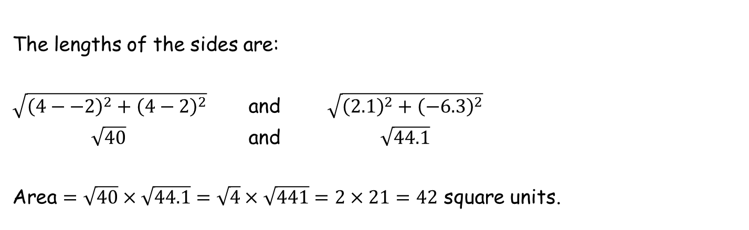
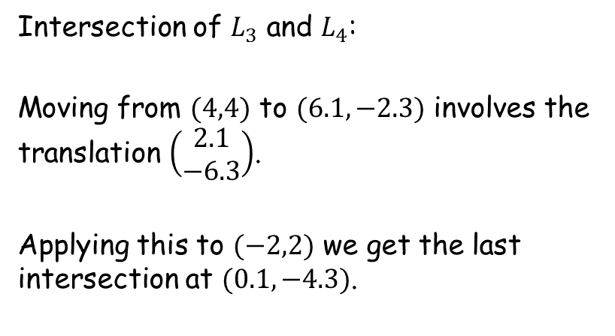
Criss-crossing
$$(4,4)$$
Intersection of $L_{3}$ and $L_{4}$:
Moving from $(4,4)$ to $(6.1,−2.3)$ involves the translation $\left(\begin{matrix}2.1 \\ −6.3\end{matrix}\right)$.
Applying this to $(−2,2)$ we get the last intersection at $(0.1,−4.3)$.
$$L_{1}$$
$$(6.1,−2.3)$$
$$(−2,2)$$
$$L_{3}$$
$$(0.1,−4.3)$$
$$L_{2}$$
$$L_{4}$$
The lengths of the sides are:
$\sqrt{{\left(4−−2\right)}^{2}+{\left(4−2\right)}^{2}}$ and $\sqrt{{\left(2.1\right)}^{2}+{\left(−6.3\right)}^{2}}$
$\sqrt{40}$ and $\sqrt{44.1}$
Area $=\sqrt{40}×\sqrt{44.1}=\sqrt{4}×\sqrt{441}=2×21=42$ square units.

Slide 12
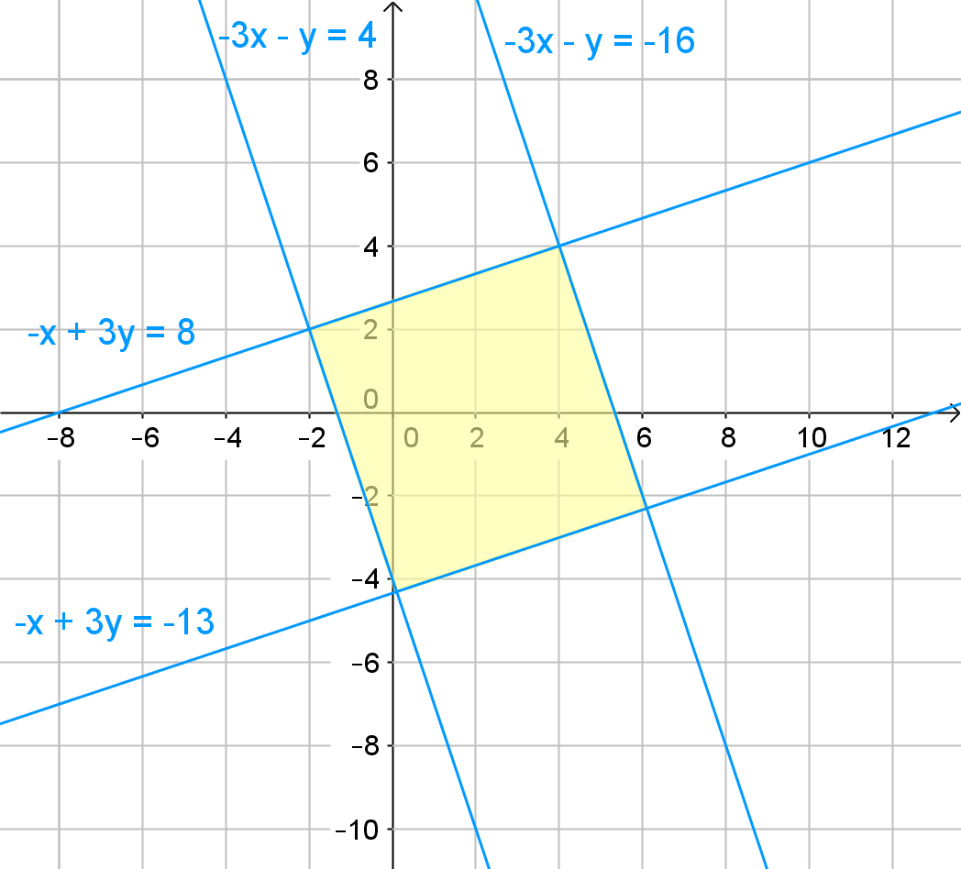

To scale
$$42$$

Slide 13
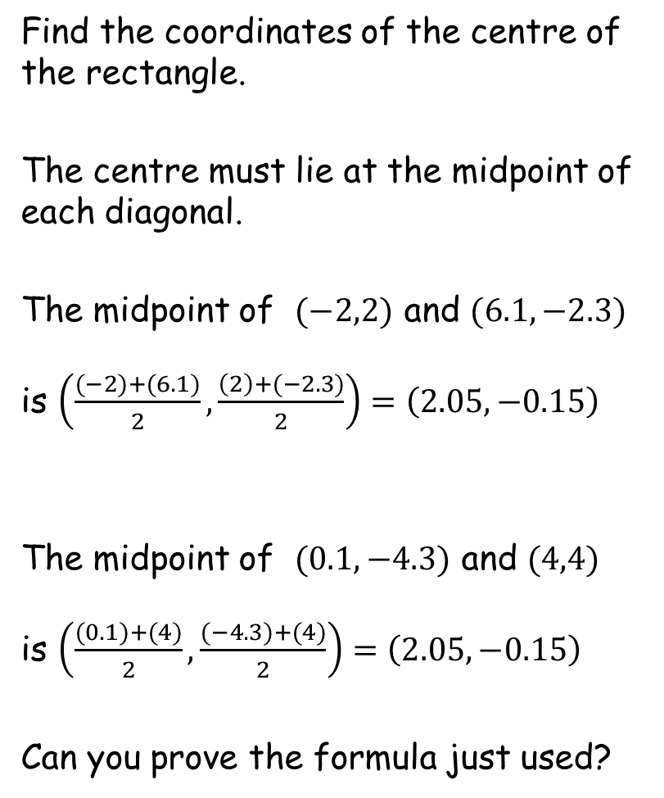
Criss-crossing
Find the coordinates of the centre of the rectangle.
The centre must lie at the midpoint of each diagonal.
The midpoint of $(−2,2)$ and $(6.1,−2.3)$
is $\left(\frac{(−2)+(6.1)}{2},\frac{\left(2\right)+(−2.3)}{2}\right)=\left(2.05,−0.15\right)$
The midpoint of $(0.1,−4.3)$ and $(4,4)$
is $\left(\frac{(0.1)+(4)}{2},\frac{(−4.3)+(4)}{2}\right)=\left(2.05,−0.15\right)$
Can you prove the formula just used?
$$(4,4)$$
x
$$(6.1,−2.3)$$
$$(−2,2)$$
$$(0.1,−4.3)$$
You could even work out the equations of the diagonals and find their intersection.

Slide 15
Note to Teacher
The answer is 42 for all.
The four lines are identical to all so all coordinates lie on these lines.

Slide 16
RESOURCES

Slide 17



x
$$B (7,5)$$
Criss-crossing
x
x
$$A (−2,2)$$
$$C (8,−8)$$
x
$$D (4,−3)$$
You are given the coordinates of four points.
Please follow the following instructions:
Find the equation of the line through $A$ and $B$, label it $L_{1}$.
Find the equation of the line through $C$ that is perpendicular to $L_{1}$, label it $L_{2}$.
Find the equation of the line through $D$ that is perpendicular to $L_{2}$, label it $L_{3}$.
Find the equation of the line through $A$ that is perpendicular to $L_{3}$, label it $L_{4}$.
The four lines intersect to form a rectangle. What is its area?
(not to scale)
SIC_52

Slide 18


x
$$B (4,4)$$
Criss-crossing
x
x
$$A (−2,2)$$
$$C (7,−5)$$
x
$$D (1,−4)$$
You are given the coordinates of four points.
Please follow the following instructions:
Find the equation of the line through $A$ and $B$, label it $L_{1}$.
Find the equation of the line through $C$ that is perpendicular to $L_{1}$, label it $L_{2}$.
Find the equation of the line through $D$ that is perpendicular to $L_{2}$, label it $L_{3}$.
Find the equation of the line through $A$ that is perpendicular to $L_{3}$, label it $L_{4}$.
The four lines intersect to form a rectangle. What is its area?
(not to scale)
SIC_52

Slide 19



x
$$B (1,3)$$
Criss-crossing
x
x
$$A (−2,2)$$
$$C (2,10)$$
x
$$D (−2,−5)$$
You are given the coordinates of four points.
Please follow the following instructions:
Find the equation of the line through $A$ and $B$, label it $L_{1}$.
Find the equation of the line through $C$ that is perpendicular to $L_{1}$, label it $L_{2}$.
Find the equation of the line through $D$ that is perpendicular to $L_{2}$, label it $L_{3}$.
Find the equation of the line through $A$ that is perpendicular to $L_{3}$, label it $L_{4}$.
The four lines intersect to form a rectangle. What is its area?
(not to scale)
SIC_52

Slide 20



x
$$B (13,7)$$
Criss-crossing
x
x
$$A (−2,2)$$
$$C (14,−26)$$
x
$$D (10,−1)$$
You are given the coordinates of four points.
Please follow the following instructions:
Find the equation of the line through $A$ and $B$, label it $L_{1}$.
Find the equation of the line through $C$ that is perpendicular to $L_{1}$, label it $L_{2}$.
Find the equation of the line through $D$ that is perpendicular to $L_{2}$, label it $L_{3}$.
Find the equation of the line through $A$ that is perpendicular to $L_{3}$, label it $L_{4}$.
The four lines intersect to form a rectangle. What is its area?
(not to scale)
SIC_52

Slide 21


x
$$B (10,6)$$
Criss-crossing
x
x
$$A (−2,2)$$
$$C (11,−17)$$
x
$$D (−8,−7)$$
You are given the coordinates of four points.
Please follow the following instructions:
Find the equation of the line through $A$ and $B$, label it $L_{1}$.
Find the equation of the line through $C$ that is perpendicular to $L_{1}$, label it $L_{2}$.
Find the equation of the line through $D$ that is perpendicular to $L_{2}$, label it $L_{3}$.
Find the equation of the line through $A$ that is perpendicular to $L_{3}$, label it $L_{4}$.
The four lines intersect to form a rectangle. What is its area?
(not to scale)
SIC_52

Slide 22



x
$$B (16,8)$$
Criss-crossing
x
x
$$A (−2,2)$$
$$C (5,1)$$
x
$$D (13,0)$$
You are given the coordinates of four points.
Please follow the following instructions:
Find the equation of the line through $A$ and $B$, label it $L_{1}$.
Find the equation of the line through $C$ that is perpendicular to $L_{1}$, label it $L_{2}$.
Find the equation of the line through $D$ that is perpendicular to $L_{2}$, label it $L_{3}$.
Find the equation of the line through $A$ that is perpendicular to $L_{3}$, label it $L_{4}$.
The four lines intersect to form a rectangle. What is its area?
(not to scale)
SIC_52

Slide 23


x
$$B (7,5)$$
Criss-crossing
x
x
$$A (−2,2)$$
$$C (12,−20)$$
x
$$D (16,1)$$
You are given the coordinates of four points.
Please follow the following instructions:
Find the equation of the line through $A$ and $B$, label it $L_{1}$.
Find the equation of the line through $C$ that is perpendicular to $L_{1}$, label it $L_{2}$.
Find the equation of the line through $D$ that is perpendicular to $L_{2}$, label it $L_{3}$.
Find the equation of the line through $A$ that is perpendicular to $L_{3}$, label it $L_{4}$.
The four lines intersect to form a rectangle. What is its area?
(not to scale)
SIC_52

Slide 24



x
$$B (19,9)$$
Criss-crossing
x
x
$$A (−2,2)$$
$$C (8,−8)$$
x
$$D (7,−2)$$
You are given the coordinates of four points.
Please follow the following instructions:
Find the equation of the line through $A$ and $B$, label it $L_{1}$.
Find the equation of the line through $C$ that is perpendicular to $L_{1}$, label it $L_{2}$.
Find the equation of the line through $D$ that is perpendicular to $L_{2}$, label it $L_{3}$.
Find the equation of the line through $A$ that is perpendicular to $L_{3}$, label it $L_{4}$.
The four lines intersect to form a rectangle. What is its area?
(not to scale)
SIC_52

Slide 25

x
$$B (1,3)$$
Criss-crossing
x
x
$$A (−2,2)$$
$$C (3,7)$$
x
$$D (−8,−7)$$
You are given the coordinates of four points.
Please follow the following instructions:
Find the equation of the line through $A$ and $B$, label it $L_{1}$.
Find the equation of the line through $C$ that is perpendicular to $L_{1}$, label it $L_{2}$.
Find the equation of the line through $D$ that is perpendicular to $L_{2}$, label it $L_{3}$.
Find the equation of the line through $A$ that is perpendicular to $L_{3}$, label it $L_{4}$.
The four lines intersect to form a rectangle. What is its area?
(not to scale)
SIC_52

Slide 26


x
$$B (13,7)$$
Criss-crossing
x
x
$$A (−2,2)$$
$$C (2,10)$$
x
$$D (−17,−10)$$
You are given the coordinates of four points.
Please follow the following instructions:
Find the equation of the line through $A$ and $B$, label it $L_{1}$.
Find the equation of the line through $C$ that is perpendicular to $L_{1}$, label it $L_{2}$.
Find the equation of the line through $D$ that is perpendicular to $L_{2}$, label it $L_{3}$.
Find the equation of the line through $A$ that is perpendicular to $L_{3}$, label it $L_{4}$.
The four lines intersect to form a rectangle. What is its area?
(not to scale)
SIC_52

Slide 27


x
$$B (10,6)$$
Criss-crossing
x
x
$$A (−2,2)$$
$$C (9,−11)$$
x
$$D (−5,−6)$$
You are given the coordinates of four points.
Please follow the following instructions:
Find the equation of the line through $A$ and $B$, label it $L_{1}$.
Find the equation of the line through $C$ that is perpendicular to $L_{1}$, label it $L_{2}$.
Find the equation of the line through $D$ that is perpendicular to $L_{2}$, label it $L_{3}$.
Find the equation of the line through $A$ that is perpendicular to $L_{3}$, label it $L_{4}$.
The four lines intersect to form a rectangle. What is its area?
(not to scale)
SIC_52

Slide 28


x
$$B (16,8)$$
Criss-crossing
x
x
$$A (−2,2)$$
$$C (10,−14)$$
x
$$D (−14,−9)$$
You are given the coordinates of four points.
Please follow the following instructions:
Find the equation of the line through $A$ and $B$, label it $L_{1}$.
Find the equation of the line through $C$ that is perpendicular to $L_{1}$, label it $L_{2}$.
Find the equation of the line through $D$ that is perpendicular to $L_{2}$, label it $L_{3}$.
Find the equation of the line through $A$ that is perpendicular to $L_{3}$, label it $L_{4}$.
The four lines intersect to form a rectangle. What is its area?
(not to scale)
SIC_52

Slide 29



x
$$B (−5,1)$$
Criss-crossing
x
x
$$A (−2,2)$$
$$C (0,16)$$
x
$$D (−11,−8)$$
You are given the coordinates of four points.
Please follow the following instructions:
Find the equation of the line through $A$ and $B$, label it $L_{1}$.
Find the equation of the line through $C$ that is perpendicular to $L_{1}$, label it $L_{2}$.
Find the equation of the line through $D$ that is perpendicular to $L_{2}$, label it $L_{3}$.
Find the equation of the line through $A$ that is perpendicular to $L_{3}$, label it $L_{4}$.
The four lines intersect to form a rectangle. What is its area?
(not to scale)
SIC_52

Slide 30


x
$$B (−8,0)$$
Criss-crossing
x
x
$$A (−2,2)$$
$$C (1,13)$$
x
$$D (13,0)$$
You are given the coordinates of four points.
Please follow the following instructions:
Find the equation of the line through $A$ and $B$, label it $L_{1}$.
Find the equation of the line through $C$ that is perpendicular to $L_{1}$, label it $L_{2}$.
Find the equation of the line through $D$ that is perpendicular to $L_{2}$, label it $L_{3}$.
Find the equation of the line through $A$ that is perpendicular to $L_{3}$, label it $L_{4}$.
The four lines intersect to form a rectangle. What is its area?
(not to scale)
SIC_52

Slide 31
x
$$B (7,5)$$
Criss-crossing
x
x
$$A (−2,2)$$
$$C (12,−20)$$
x
$$D (7,−2)$$
You are given the coordinates of four points.
Please follow the following instructions:
Find the equation of the line through $A$ and $B$, label it $L_{1}$.
Find the equation of the line through $C$ that is perpendicular to $L_{1}$, label it $L_{2}$.
Find the equation of the line through $D$ that is perpendicular to $L_{2}$, label it $L_{3}$.
Find the equation of the line through $A$ that is perpendicular to $L_{3}$, label it $L_{4}$.
The four lines intersect to form a rectangle. What is its area?
(not to scale)
SIC_52

Slide 32

x
$$B (19,9)$$
Criss-crossing
x
x
$$A (−2,2)$$
$$C (14,−26)$$
x
$$D (19,2)$$
You are given the coordinates of four points.
Please follow the following instructions:
Find the equation of the line through $A$ and $B$, label it $L_{1}$.
Find the equation of the line through $C$ that is perpendicular to $L_{1}$, label it $L_{2}$.
Find the equation of the line through $D$ that is perpendicular to $L_{2}$, label it $L_{3}$.
Find the equation of the line through $A$ that is perpendicular to $L_{3}$, label it $L_{4}$.
The four lines intersect to form a rectangle. What is its area?
(not to scale)
SIC_52

