Slide 1
Kitchen Table
From a question in the UKMT JMC 2000 paper

Slide 2
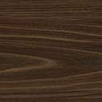

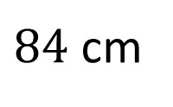
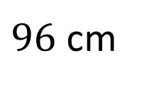
Kitchen Table
Four identical blocks of wood are placed touching a table as shown in the diagram.
Find the height of the table.
$96$ cm
$84$ cm
(not drawn to scale)

Slide 3
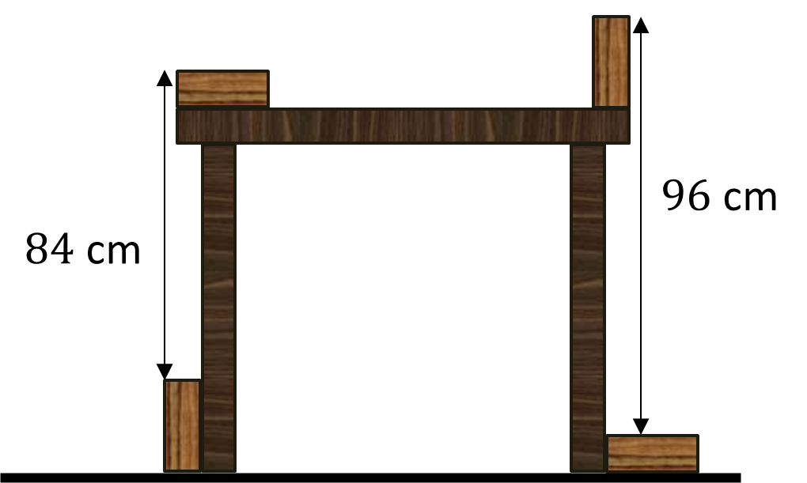

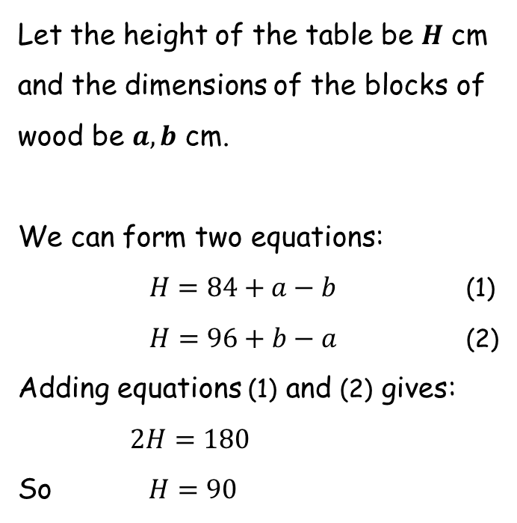



Kitchen Table
Let the height of the table be $H$ cm and the dimensions of the blocks of wood be $a,b$ cm.
We can form two equations:
$H=84+a−b$ (1)
$H=96+b−a$ (2)
Adding equations (1) and (2) gives:
$2H=180$
So $H=90$
$b$ cm
$a$ cm
$H$ cm
The height of the table is $90$ cm.

Slide 5
Note to Teacher
Not all answers are the same.
The answer for each worksheet is simply the average of the two numbers on the worksheet.

Slide 6
RESOURCES

Slide 7
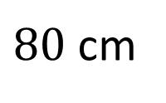
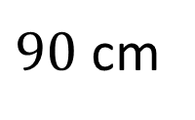
Kitchen Table
Four identical blocks of wood are placed touching a table as shown in the diagram.
Find the height of the table.
$90$ cm
$80$ cm
(not drawn to scale)
SIC_94

Slide 8
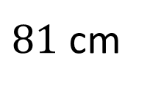
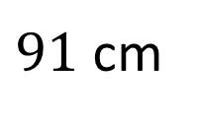
Kitchen Table
Four identical blocks of wood are placed touching a table as shown in the diagram.
Find the height of the table.
$91$ cm
$81$ cm
(not drawn to scale)
SIC_94

Slide 9
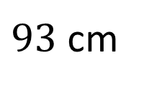
Kitchen Table
Four identical blocks of wood are placed touching a table as shown in the diagram.
Find the height of the table.
$93$ cm
$81$ cm
(not drawn to scale)
SIC_94

Slide 10
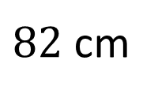
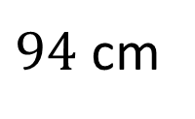
Kitchen Table
Four identical blocks of wood are placed touching a table as shown in the diagram.
Find the height of the table.
$94$ cm
$82$ cm
(not drawn to scale)
SIC_94

Slide 11
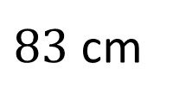
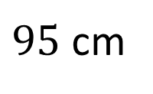
Kitchen Table
Four identical blocks of wood are placed touching a table as shown in the diagram.
Find the height of the table.
$95$ cm
$83$ cm
(not drawn to scale)
SIC_94

Slide 12
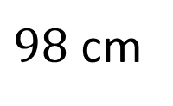
Kitchen Table
Four identical blocks of wood are placed touching a table as shown in the diagram.
Find the height of the table.
$98$ cm
$84$ cm
(not drawn to scale)
SIC_94

Slide 13
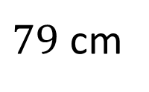
Kitchen Table
Four identical blocks of wood are placed touching a table as shown in the diagram.
Find the height of the table.
$91$ cm
$79$ cm
(not drawn to scale)
SIC_94

Slide 14
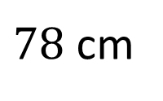
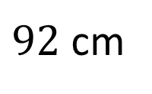
Kitchen Table
Four identical blocks of wood are placed touching a table as shown in the diagram.
Find the height of the table.
$92$ cm
$78$ cm
(not drawn to scale)
SIC_94

Slide 15
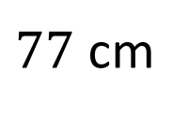
Kitchen Table
Four identical blocks of wood are placed touching a table as shown in the diagram.
Find the height of the table.
$93$ cm
$77$ cm
(not drawn to scale)
SIC_94

Slide 16
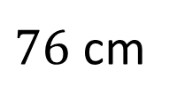
Kitchen Table
Four identical blocks of wood are placed touching a table as shown in the diagram.
Find the height of the table.
$94$ cm
$76$ cm
(not drawn to scale)
SIC_94

Slide 17
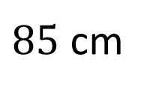
Kitchen Table
Four identical blocks of wood are placed touching a table as shown in the diagram.
Find the height of the table.
$95$ cm
$85$ cm
(not drawn to scale)
SIC_94

Slide 18
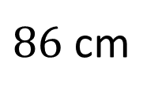
Kitchen Table
Four identical blocks of wood are placed touching a table as shown in the diagram.
Find the height of the table.
$96$ cm
$86$ cm
(not drawn to scale)
SIC_94

Slide 19
Kitchen Table
Four identical blocks of wood are placed touching a table as shown in the diagram.
Find the height of the table.
$98$ cm
$86$ cm
(not drawn to scale)
SIC_94

Slide 20
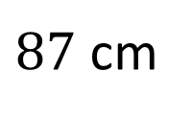
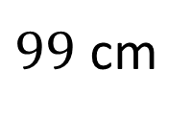
Kitchen Table
Four identical blocks of wood are placed touching a table as shown in the diagram.
Find the height of the table.
$99$ cm
$87$ cm
(not drawn to scale)
SIC_94

Slide 21
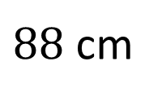
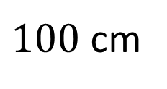
Kitchen Table
Four identical blocks of wood are placed touching a table as shown in the diagram.
Find the height of the table.
$100$ cm
$88$ cm
(not drawn to scale)
SIC_94

Slide 22
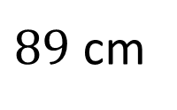
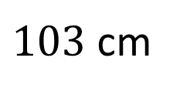
Kitchen Table
Four identical blocks of wood are placed touching a table as shown in the diagram.
Find the height of the table.
$103$ cm
$89$ cm
(not drawn to scale)
SIC_94

Slide 23
Kitchen Table
Four identical blocks of wood are placed touching a table as shown in the diagram.
Find the height of the table.
$96$ cm
$84$ cm
(not drawn to scale)
SIC_94

Slide 24
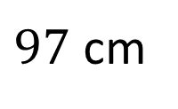
Kitchen Table
Four identical blocks of wood are placed touching a table as shown in the diagram.
Find the height of the table.
$97$ cm
$83$ cm
(not drawn to scale)
SIC_94

Slide 25
Kitchen Table
Four identical blocks of wood are placed touching a table as shown in the diagram.
Find the height of the table.
$98$ cm
$82$ cm
(not drawn to scale)
SIC_94

Slide 26
Kitchen Table
Four identical blocks of wood are placed touching a table as shown in the diagram.
Find the height of the table.
$99$ cm
$81$ cm
(not drawn to scale)
SIC_94

Slide 27
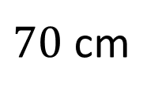
Kitchen Table
Four identical blocks of wood are placed touching a table as shown in the diagram.
Find the height of the table.
$90$ cm
$70$ cm
(not drawn to scale)
SIC_94

Slide 28
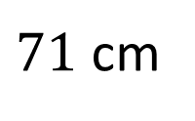
Kitchen Table
Four identical blocks of wood are placed touching a table as shown in the diagram.
Find the height of the table.
$91$ cm
$71$ cm
(not drawn to scale)
SIC_94

Slide 29
Kitchen Table
Four identical blocks of wood are placed touching a table as shown in the diagram.
Find the height of the table.
$93$ cm
$71$ cm
(not drawn to scale)
SIC_94

Slide 30
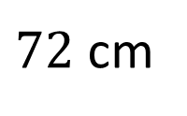
Kitchen Table
Four identical blocks of wood are placed touching a table as shown in the diagram.
Find the height of the table.
$94$ cm
$72$ cm
(not drawn to scale)
SIC_94

