Slide 1
L-centre

Slide 2
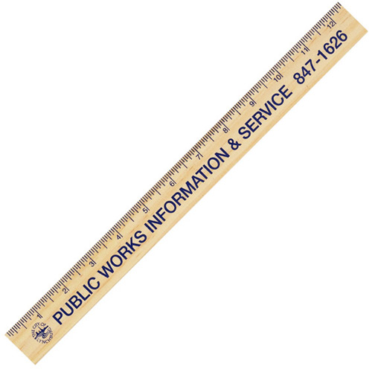
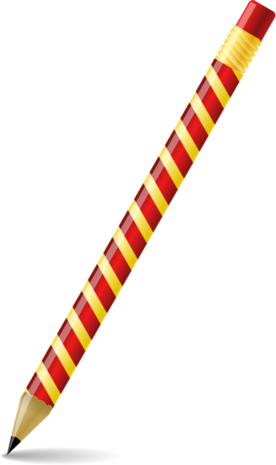
L-centre
Using only a straight edge and pencil find the centre of mass of the plane L-shaped figure.

Slide 3
L-centre
Hint:
The centre of mass of two combined objects will lie on a line joining their individual centres of mass.

Slide 4
L-centre
x
x
The centre of mass must lie on this line

Slide 5
L-centre
x
x
x
The centre of mass must lie on this line also
x

Slide 6
L-centre
x
x
x
x
The centre of mass must be here
x

Slide 7
L-centre
x

Slide 8
L-centre
x
Check:
If you were to re-place the removed rectangle the centres of mass must all still lie on a straight line and the result must be dead centre of the overall rectangle.

Slide 9
L-centre
x
So what are the conditions for the centre of mass of the L-shape to be in the crook of the L-shape?

Slide 10
L-centre
x
The above gives a clue.

Slide 11
L-centre
x
It must lie on the diagonal of the original rectangle.

Slide 12
L-centre
x
It must lie on the diagonal of the original rectangle.
But where on the diagonal?

Slide 13
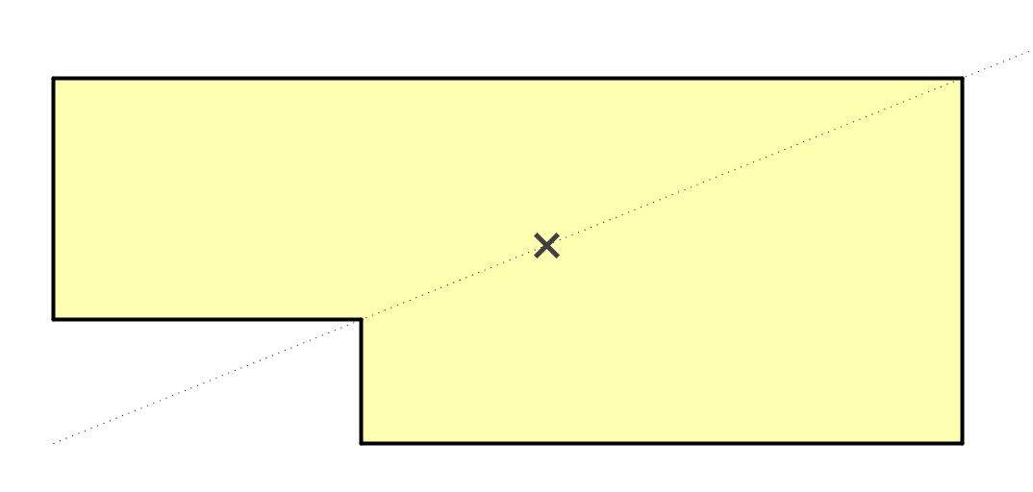
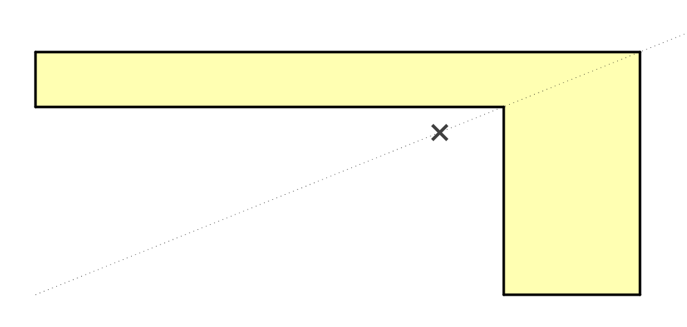
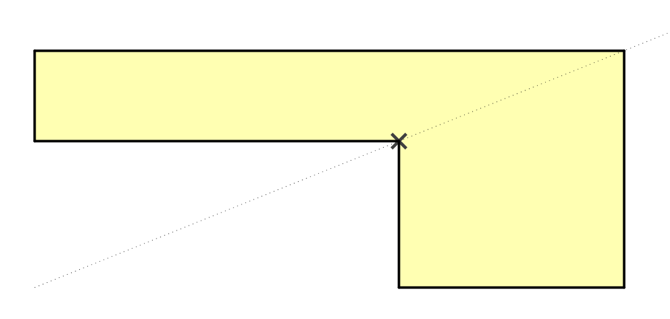
L-centre
cut-out too large
cut-out too small
cut-out just right

Slide 14





$$a$$
x
$$ka$$
Taking “Moments” about left hand edge:
$a.b.\frac{a}{2}−ka.kb.\frac{ka}{2}=\left(a.b−ka.kb\right).ka$
$\frac{a^{2}b}{2}\left(1−k^{3}\right)=a^{2}b\left(1−k^{2}\right)k$
$k^{3}−2k+1=0$
$k=1$ is a solution to the above so $\left(k−1\right)$ is a factor.
$\left(k^{2}+k−1\right)\left(k−1\right)=0$
$$b$$
$$kb$$

Slide 15

$$a$$
x
$$ka$$
Taking “Moments” about left hand edge:
$a.b.\frac{a}{2}−ka.kb.\frac{ka}{2}=\left(a.b−ka.kb\right).ka$
$\frac{a^{2}b}{2}\left(1−k^{3}\right)=a^{2}b\left(1−k^{2}\right)k$
$k^{3}−2k+1=0$
$k=1$ is a solution to the above so $\left(k−1\right)$ is a factor.
$\left(k^{2}+k−1\right)\left(k−1\right)=0$
$k=\frac{−1+\sqrt{5}}{2}$ (the reciprocal of $ϕ$ , the golden ratio!)
$$b$$
$$kb$$

Slide 16


$$a$$
x
$$\frac{a}{ϕ}$$
$$b$$
$$\frac{b}{ϕ}$$
So this is the requirement for the centre of mass to be as shown.

Slide 17

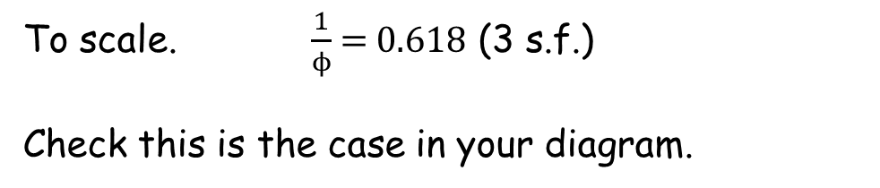




$$a$$
x
$$ϕa$$
$$\frac{a}{ϕ}$$
$$b$$
$$\frac{a}{ϕ}$$
$$\frac{b}{ϕ}$$
$$ϕb$$
To scale. $\frac{1}{ϕ}$ = 0.618 (3 s.f.)
Check this is the case in your diagram.

Slide 19
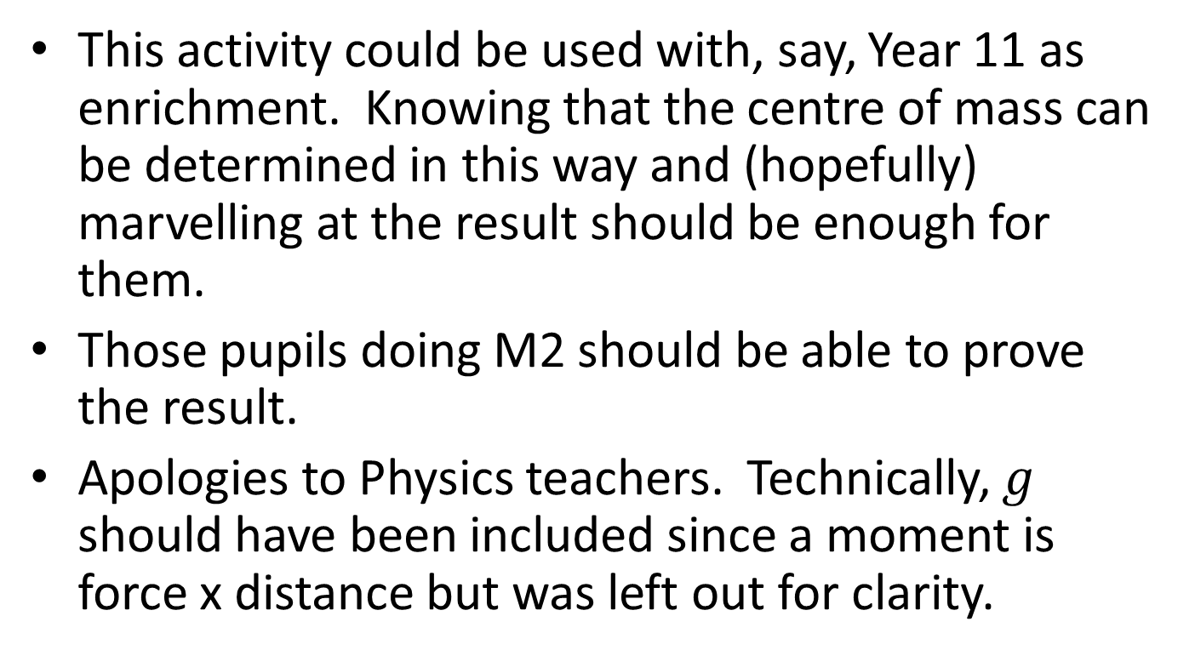
NOTE TO TEACHER
This activity could be used with, say, Year 11 as enrichment. Knowing that the centre of mass can be determined in this way and (hopefully) marvelling at the result should be enough for them.
Those pupils doing M2 should be able to prove the result.
Apologies to Physics teachers. Technically, $g$ should have been included since a moment is force x distance but was left out for clarity.

Slide 20
RESOURCES

Slide 21
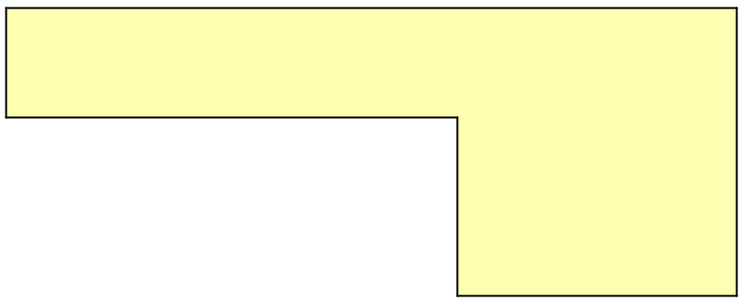
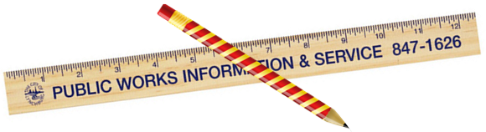
L-centre
Using only a straight edge and pencil find the centre of mass of the plane L-shaped figure.
SIC_34

Slide 22
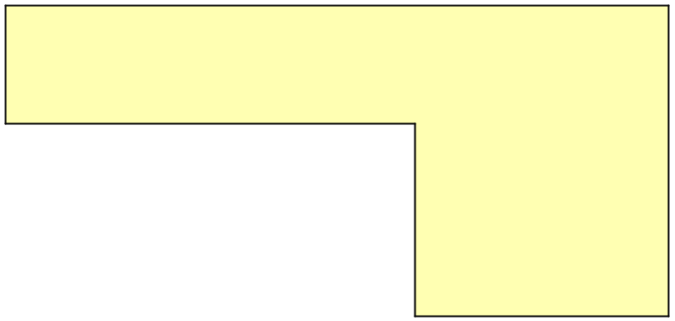
L-centre
Using only a straight edge and pencil find the centre of mass of the plane L-shaped figure.
SIC_34

Slide 23
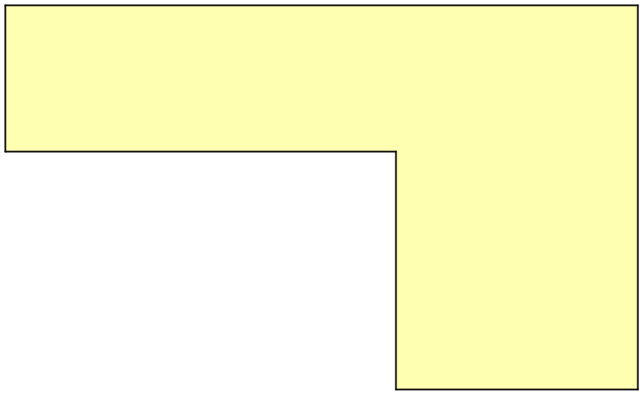
L-centre
Using only a straight edge and pencil find the centre of mass of the plane L-shaped figure.
SIC_34

Slide 24
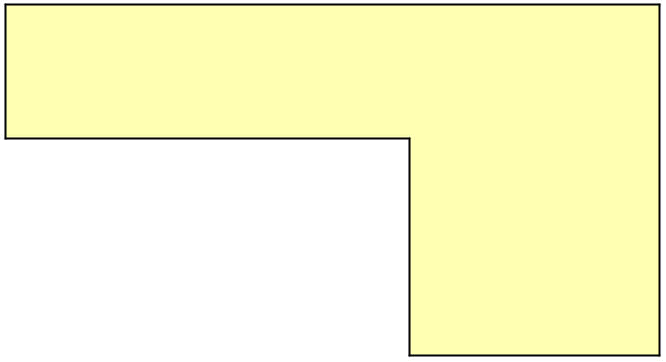
L-centre
Using only a straight edge and pencil find the centre of mass of the plane L-shaped figure.
SIC_34

Slide 25

L-centre
Using only a straight edge and pencil find the centre of mass of the plane L-shaped figure.
SIC_34

Slide 26
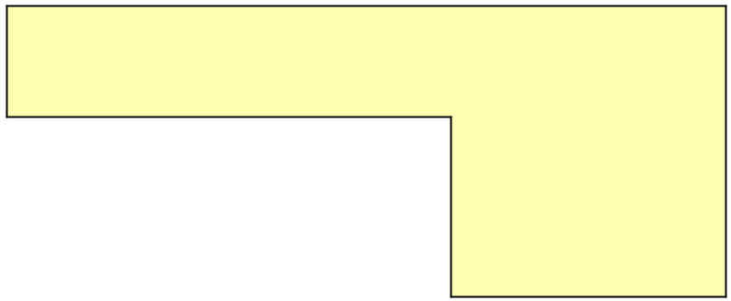
L-centre
Using only a straight edge and pencil find the centre of mass of the plane L-shaped figure.
SIC_34

Slide 27

L-centre
Using only a straight edge and pencil find the centre of mass of the plane L-shaped figure.
SIC_34

Slide 28

L-centre
Using only a straight edge and pencil find the centre of mass of the plane L-shaped figure.
SIC_34

Slide 29
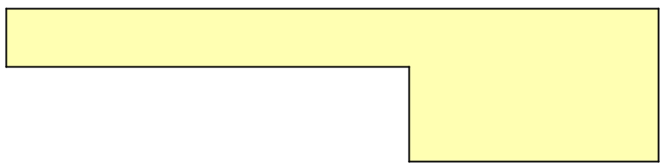
L-centre
Using only a straight edge and pencil find the centre of mass of the plane L-shaped figure.
SIC_34

Slide 30
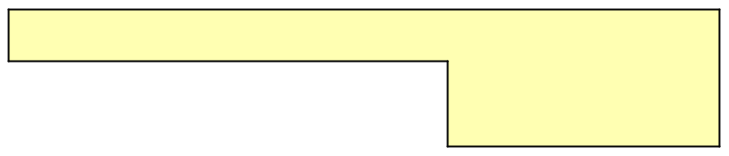
L-centre
Using only a straight edge and pencil find the centre of mass of the plane L-shaped figure.
SIC_34

Slide 31
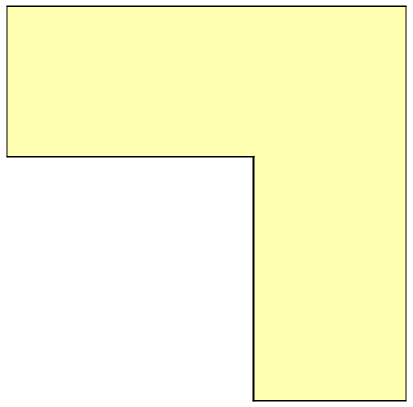
L-centre
SIC_34
Using only a straight edge and pencil find the centre of mass of the plane L-shaped figure.

Slide 32

L-centre
SIC_34
Using only a straight edge and pencil find the centre of mass of the plane L-shaped figure.

Slide 33
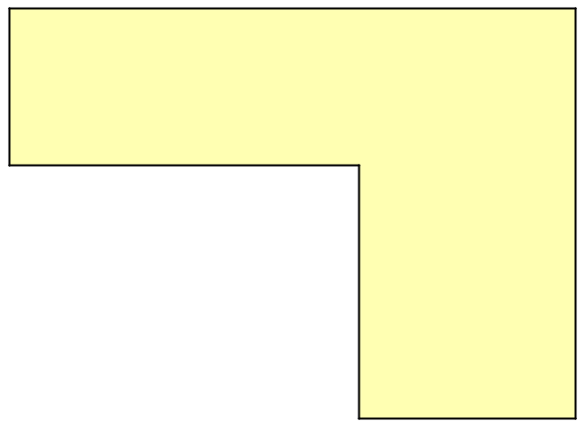
L-centre
SIC_34
Using only a straight edge and pencil find the centre of mass of the plane L-shaped figure.

Slide 34

L-centre
SIC_34
Using only a straight edge and pencil find the centre of mass of the plane L-shaped figure.

Slide 35
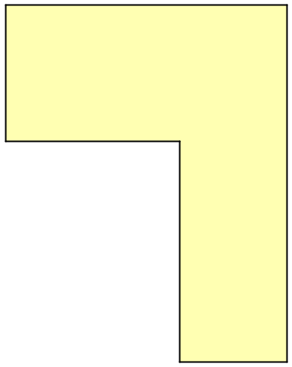
L-centre
SIC_34
Using only a straight edge and pencil find the centre of mass of the plane L-shaped figure.

