Slide 1
Multi-simultaneous

Slide 2
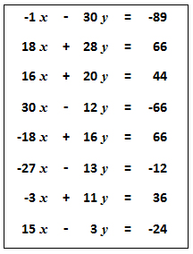
Multi-simultaneous
All of these straight lines meet at one point.
What are its coordinates?

Slide 4
Note to Teacher
The solution is: $x=−1 , y=3$

Slide 6
Resources
The spreadsheet can be used to generate more worksheets

Slide 7
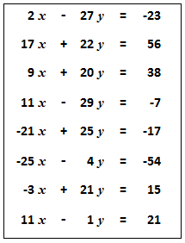
Multi-simultaneous
Multi-simultaneous
All of these straight lines meet at one point.
What are its coordinates?
All of these straight lines meet at one point.
What are its coordinates?
SIC_17
SIC_17

Slide 8
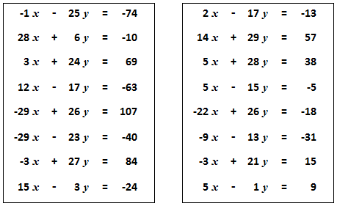
Multi-simultaneous
Multi-simultaneous
All of these straight lines meet at one point.
What are its coordinates?
All of these straight lines meet at one point.
What are its coordinates?
SIC_17
SIC_17

Slide 9
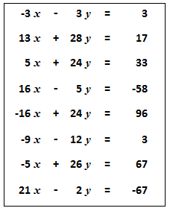
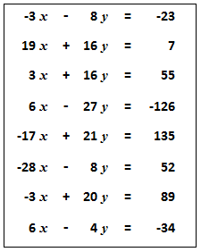
Multi-simultaneous
Multi-simultaneous
All of these straight lines meet at one point.
What are its coordinates?
All of these straight lines meet at one point.
What are its coordinates?
SIC_17
SIC_17

Slide 10
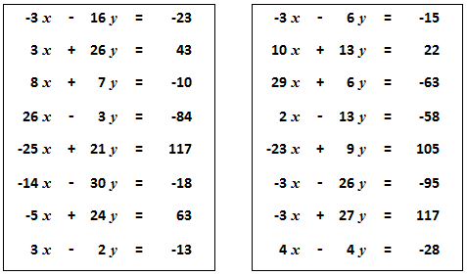
Multi-simultaneous
Multi-simultaneous
All of these straight lines meet at one point.
What are its coordinates?
All of these straight lines meet at one point.
What are its coordinates?
SIC_17
SIC_17

Slide 11
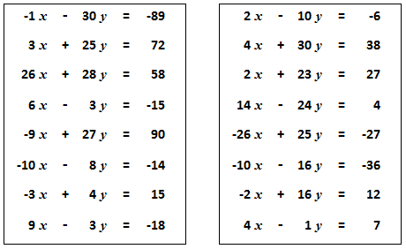
Multi-simultaneous
Multi-simultaneous
All of these straight lines meet at one point.
What are its coordinates?
All of these straight lines meet at one point.
What are its coordinates?
SIC_17
SIC_17

Slide 12
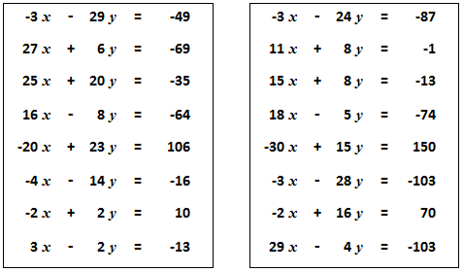
Multi-simultaneous
Multi-simultaneous
All of these straight lines meet at one point.
What are its coordinates?
All of these straight lines meet at one point.
What are its coordinates?
SIC_17
SIC_17

Slide 13
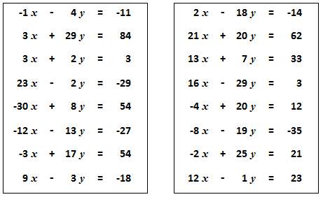
Multi-simultaneous
Multi-simultaneous
All of these straight lines meet at one point.
What are its coordinates?
All of these straight lines meet at one point.
What are its coordinates?
SIC_17
SIC_17

Slide 14
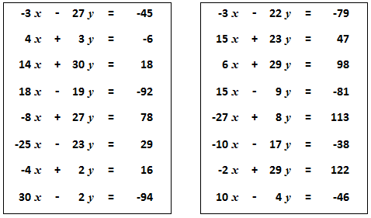
Multi-simultaneous
Multi-simultaneous
All of these straight lines meet at one point.
What are its coordinates?
All of these straight lines meet at one point.
What are its coordinates?
SIC_17
SIC_17

Slide 15
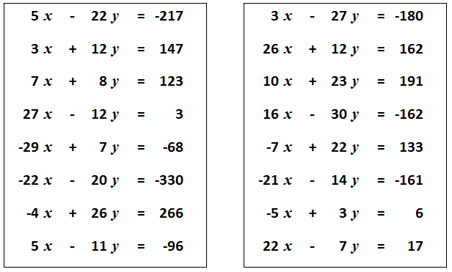
Multi-simultaneous
Multi-simultaneous
All of these straight lines meet at one point.
What are its coordinates?
All of these straight lines meet at one point.
What are its coordinates?
SIC_17
SIC_17

Slide 16
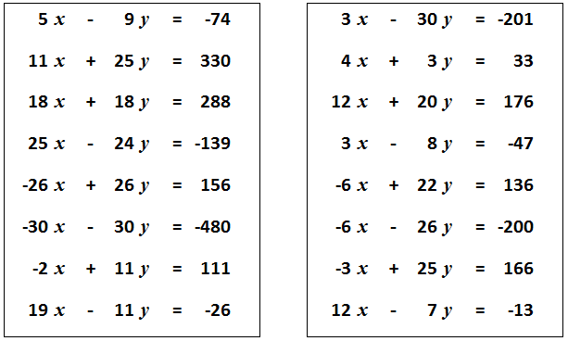
Multi-simultaneous
Multi-simultaneous
All of these straight lines meet at one point.
What are its coordinates?
All of these straight lines meet at one point.
What are its coordinates?
SIC_17
SIC_17

Slide 17
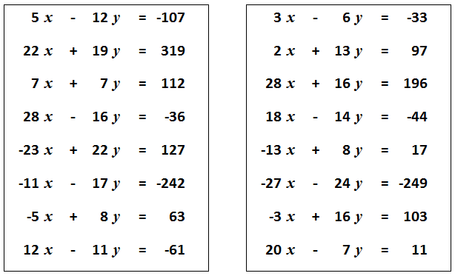
Multi-simultaneous
Multi-simultaneous
All of these straight lines meet at one point.
What are its coordinates?
All of these straight lines meet at one point.
What are its coordinates?
SIC_17
SIC_17

Slide 18
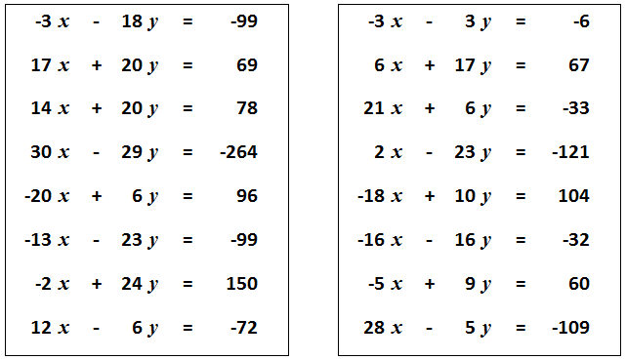
Multi-simultaneous
Multi-simultaneous
All of these straight lines meet at one point.
What are its coordinates?
All of these straight lines meet at one point.
What are its coordinates?
SIC_17
SIC_17

Slide 19
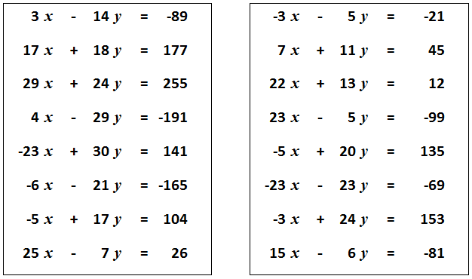
All of these straight lines meet at one point.
What are its coordinates?
All of these straight lines meet at one point.
What are its coordinates?
SIC_17
SIC_17

