Slide 1
Y-Intercepts
With thanks to Daniel Kelsall for the idea.

Slide 2



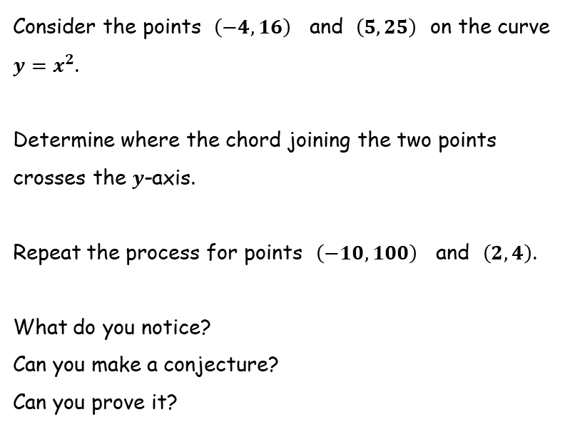



Y-Intercepts
$$y$$
$$y=x^{2}$$
Consider the points $\left(−4, 16\right)$ and $\left(5,25\right)$ on the curve $y=x^{2}$.
Determine where the chord joining the two points crosses the $y$-axis.
Repeat the process for points $\left(−10,100\right)$ and $\left(2,4\right)$.
What do you notice?
Can you make a conjecture?
Can you prove it?
$$x$$
$$y$$
$$y=x^{2}$$
$$x$$

Slide 3





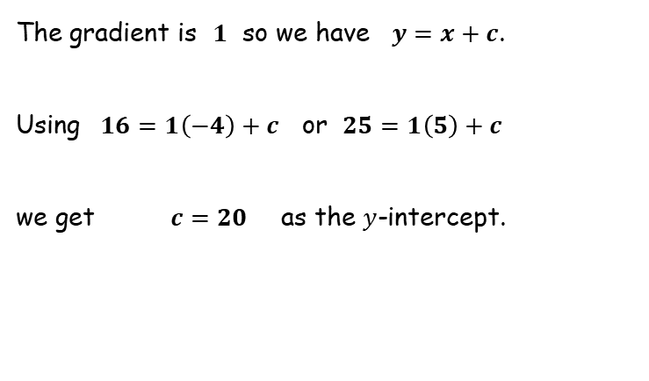




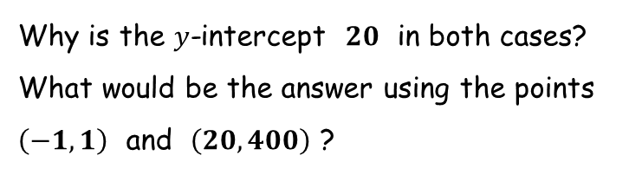




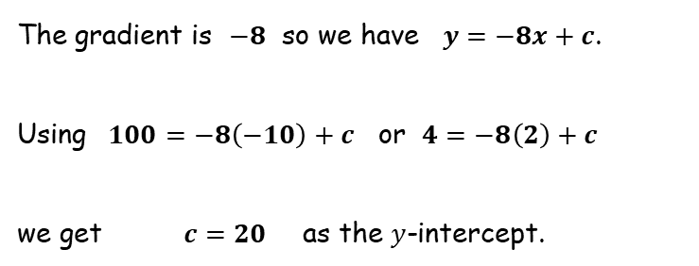
Y-Intercepts
$$y$$
$$y=x^{2}$$
The gradient is $1$ so we have $y=x+c$.
Using $16=1\left(−4\right)+c$ or $25=1\left(5\right)+c$
we get $c=20$ as the $y$-intercept.
$$\left(5,25\right)$$
$$1$$
$$20$$
$$1$$
$$9$$
$$\left(−4, 16\right)$$
$$9$$
$$x$$
The gradient is $−8$ so we have $y=−8x+c$.
Using $100=−8\left(−10\right)+c$ or $4=−8\left(2\right)+c$
we get $c=20$ as the $y$-intercept.
$$y$$
$$y=x^{2}$$
$$\left(−10, 100\right)$$
$$−8$$
$$−96$$
$$1$$
$$20$$
Why is the $y$-intercept $20$ in both cases?
What would be the answer using the points $\left(−1,1\right)$ and $\left(20,400\right)$ ?
$$12$$
$$\left(2,4\right)$$
$$x$$

Slide 4
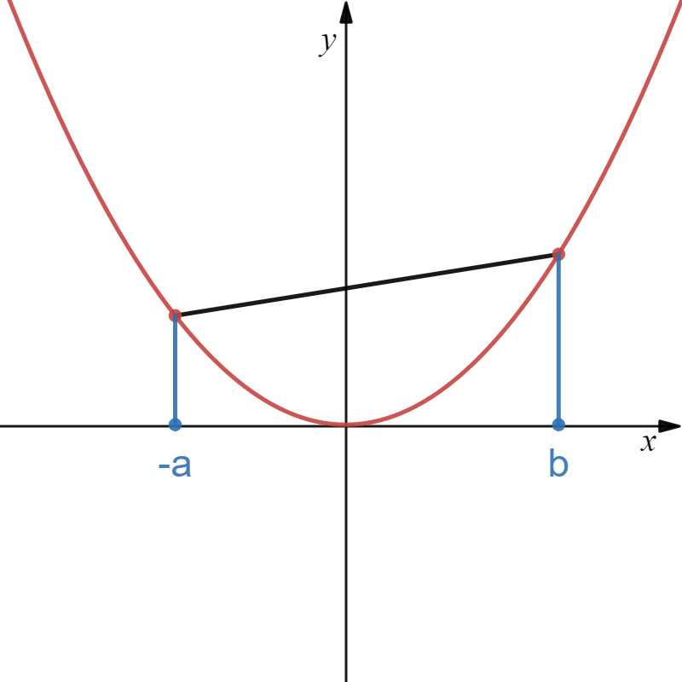
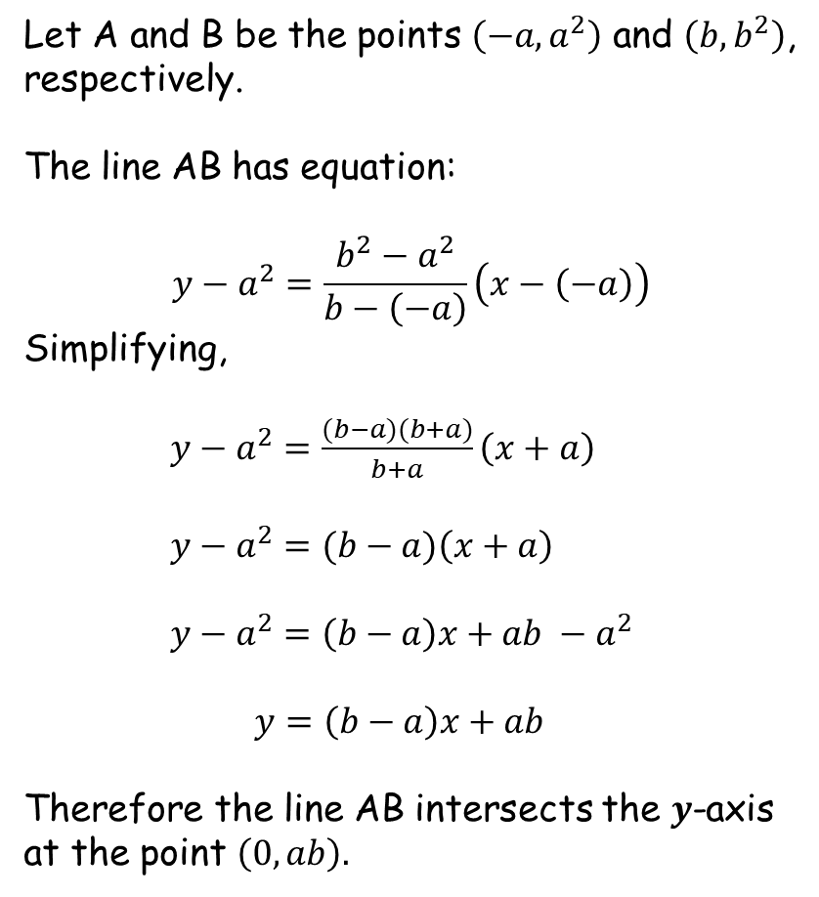

Y-Intercepts
Let A and B be the points $\left(−a, a^{2}\right)$ and $\left(b,b^{2}\right)$, respectively.
The line AB has equation:
$$y−a^{2}=\frac{b^{2}−a^{2}}{b−\left(−a\right)}\left(x−\left(−a\right)\right)$$
Simplifying,
$y−a^{2}=\frac{(b−a)(b+a)}{b+a}\left(x+a\right)$
$y−a^{2}=(b−a)\left(x+a\right)$
$y−a^{2}=\left(b−a\right)x+ab −a^{2}$
$y=\left(b−a\right)x+ab$
Therefore the line AB intersects the $y$-axis at the point $\left(0,ab\right).$
(using: $\frac{y−y_{1}}{x−x_{1}}=m$ )
B
A
(b,b²)
(-a,a²)

Slide 6
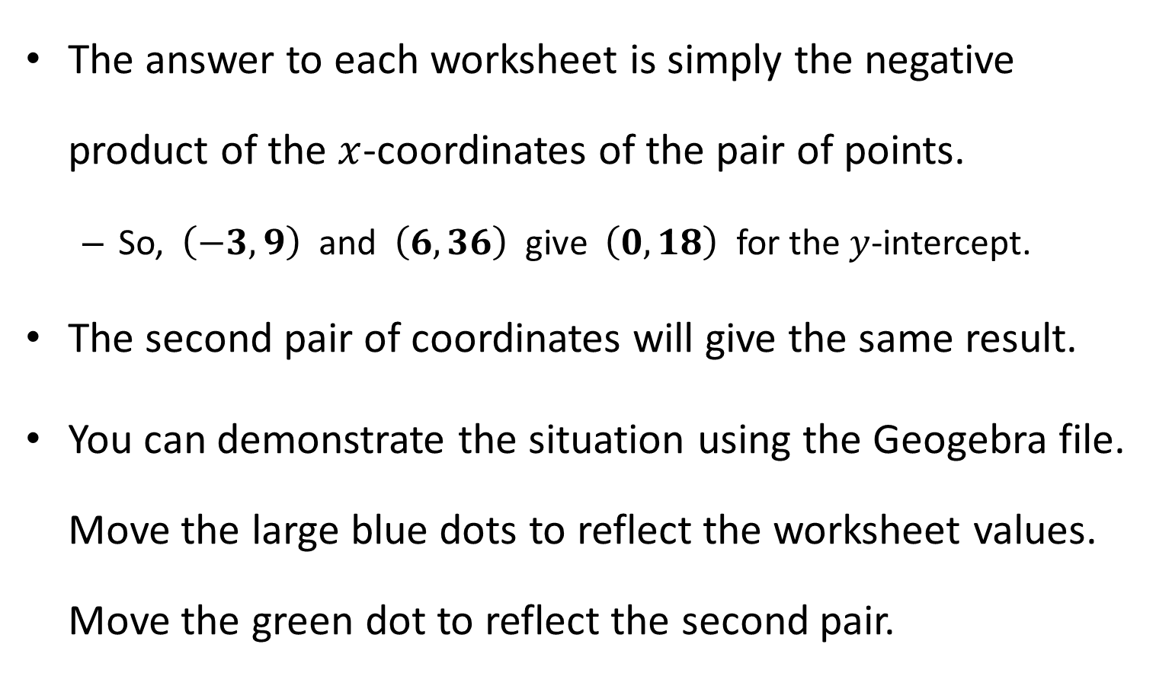
Note to Teacher
The answer to each worksheet is simply the negative product of the $x$-coordinates of the pair of points.
So, $\left(−3,9\right)$ and $\left(6,36\right)$ give $\left(0,18\right)$ for the $y$-intercept.
The second pair of coordinates will give the same result.
You can demonstrate the situation using the Geogebra file. Move the large blue dots to reflect the worksheet values. Move the green dot to reflect the second pair.

Slide 7
RESOURCES

Slide 8



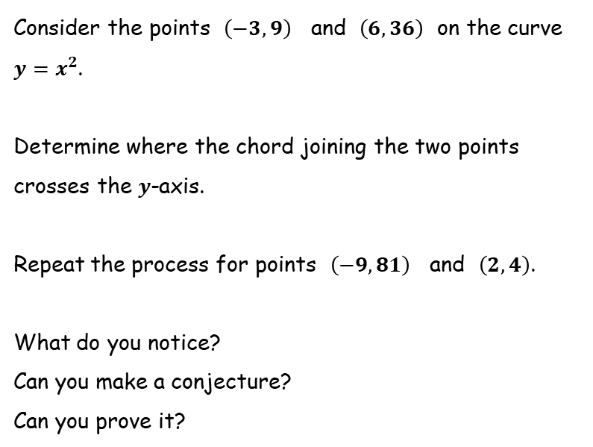



Y-Intercepts
SIC_89
$$y$$
$$y=x^{2}$$
Consider the points $\left(−3, 9\right)$ and $\left(6,36\right)$ on the curve $y=x^{2}$.
Determine where the chord joining the two points crosses the $y$-axis.
Repeat the process for points $\left(−9,81\right)$ and $\left(2,4\right)$.
What do you notice?
Can you make a conjecture?
Can you prove it?
$$x$$
$$y$$
$$y=x^{2}$$
$$x$$

Slide 9
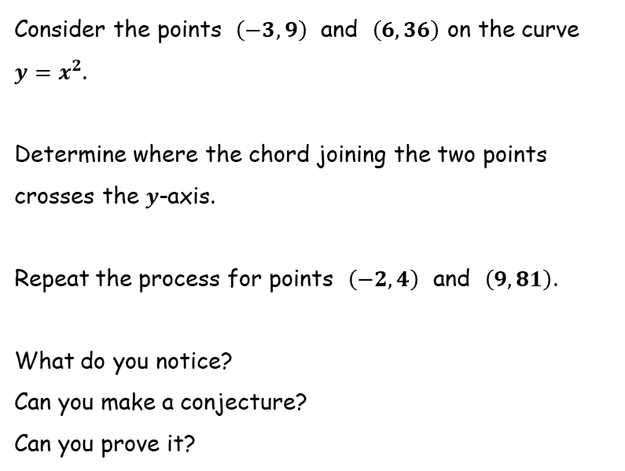
Y-Intercepts
SIC_89
$$y$$
$$y=x^{2}$$
Consider the points $\left(−3, 9\right)$ and $\left(6,36\right)$ on the curve $y=x^{2}$.
Determine where the chord joining the two points crosses the $y$-axis.
Repeat the process for points $\left(−2,4\right)$ and $\left(9,81\right)$.
What do you notice?
Can you make a conjecture?
Can you prove it?
$$x$$
$$y$$
$$y=x^{2}$$
$$x$$

Slide 10
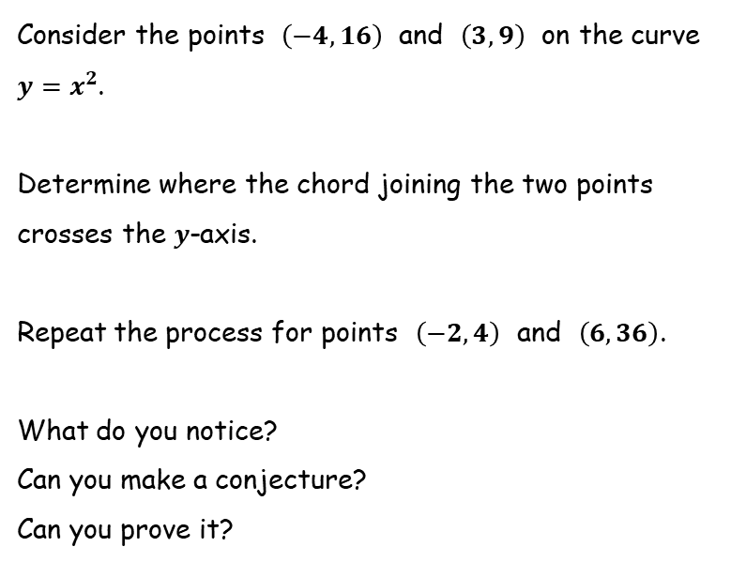
Y-Intercepts
SIC_89
$$y$$
$$y=x^{2}$$
Consider the points $\left(−4, 16\right)$ and $\left(3,9\right)$ on the curve $y=x^{2}$.
Determine where the chord joining the two points crosses the $y$-axis.
Repeat the process for points $\left(−2,4\right)$ and $\left(6,36\right)$.
What do you notice?
Can you make a conjecture?
Can you prove it?
$$x$$
$$y$$
$$y=x^{2}$$
$$x$$

Slide 11
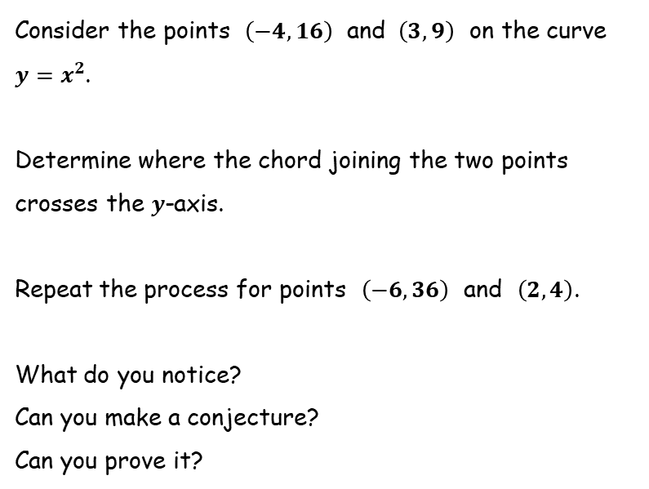
Y-Intercepts
SIC_89
$$y$$
$$y=x^{2}$$
Consider the points $\left(−4, 16\right)$ and $\left(3,9\right)$ on the curve $y=x^{2}$.
Determine where the chord joining the two points crosses the $y$-axis.
Repeat the process for points $\left(−6,36\right)$ and $\left(2,4\right)$.
What do you notice?
Can you make a conjecture?
Can you prove it?
$$x$$
$$y$$
$$y=x^{2}$$
$$x$$

Slide 12
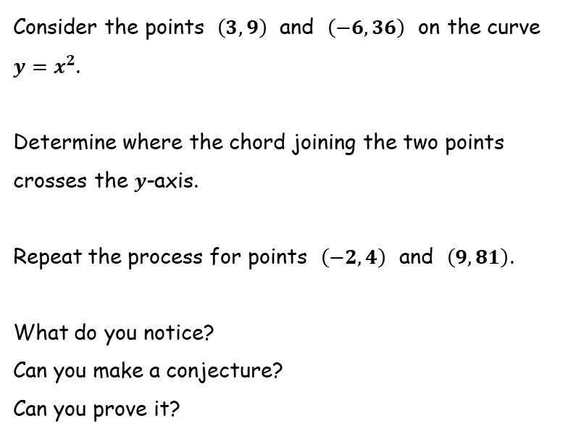
Y-Intercepts
SIC_89
$$y$$
$$y=x^{2}$$
Consider the points $\left(3, 9\right)$ and $\left(−6,36\right)$ on the curve $y=x^{2}$.
Determine where the chord joining the two points crosses the $y$-axis.
Repeat the process for points $\left(−2,4\right)$ and $\left(9,81\right)$.
What do you notice?
Can you make a conjecture?
Can you prove it?
$$x$$
$$y$$
$$y=x^{2}$$
$$x$$

Slide 13
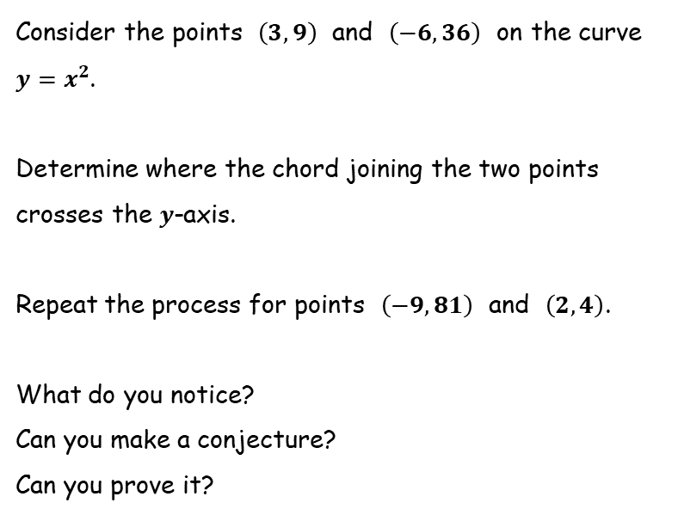
Y-Intercepts
SIC_89
$$y$$
$$y=x^{2}$$
Consider the points $\left(3, 9\right)$ and $\left(−6,36\right)$ on the curve $y=x^{2}$.
Determine where the chord joining the two points crosses the $y$-axis.
Repeat the process for points $\left(−9,81\right)$ and $\left(2,4\right)$.
What do you notice?
Can you make a conjecture?
Can you prove it?
$$x$$
$$y$$
$$y=x^{2}$$
$$x$$

Slide 14
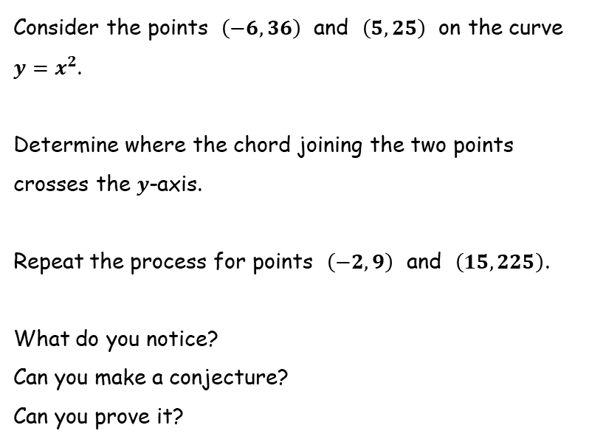
Y-Intercepts
SIC_89
$$y$$
$$y=x^{2}$$
Consider the points $\left(−6, 36\right)$ and $\left(5,25\right)$ on the curve $y=x^{2}$.
Determine where the chord joining the two points crosses the $y$-axis.
Repeat the process for points $\left(−2,9\right)$ and $\left(15,225\right)$.
What do you notice?
Can you make a conjecture?
Can you prove it?
$$x$$
$$y$$
$$y=x^{2}$$
$$x$$

Slide 15
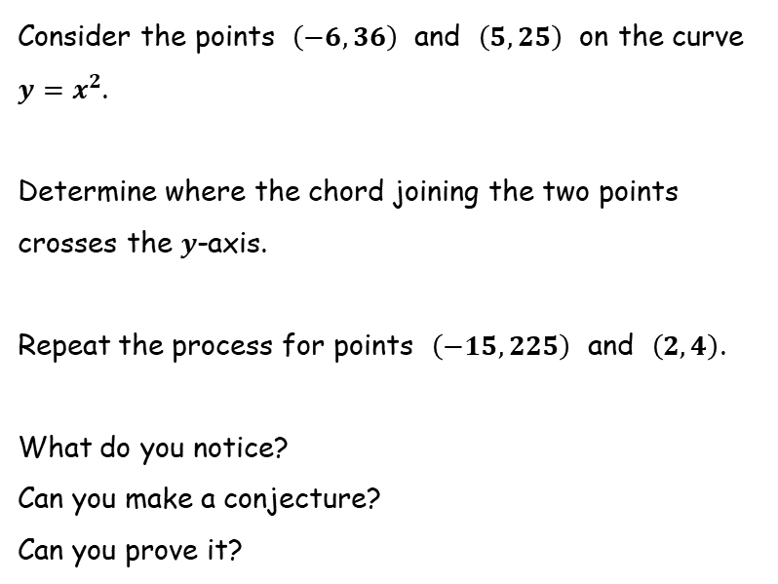
Y-Intercepts
SIC_89
$$y$$
$$y=x^{2}$$
Consider the points $\left(−6, 36\right)$ and $\left(5,25\right)$ on the curve $y=x^{2}$.
Determine where the chord joining the two points crosses the $y$-axis.
Repeat the process for points $\left(−15,225\right)$ and $\left(2,4\right)$.
What do you notice?
Can you make a conjecture?
Can you prove it?
$$x$$
$$y$$
$$y=x^{2}$$
$$x$$

Slide 16
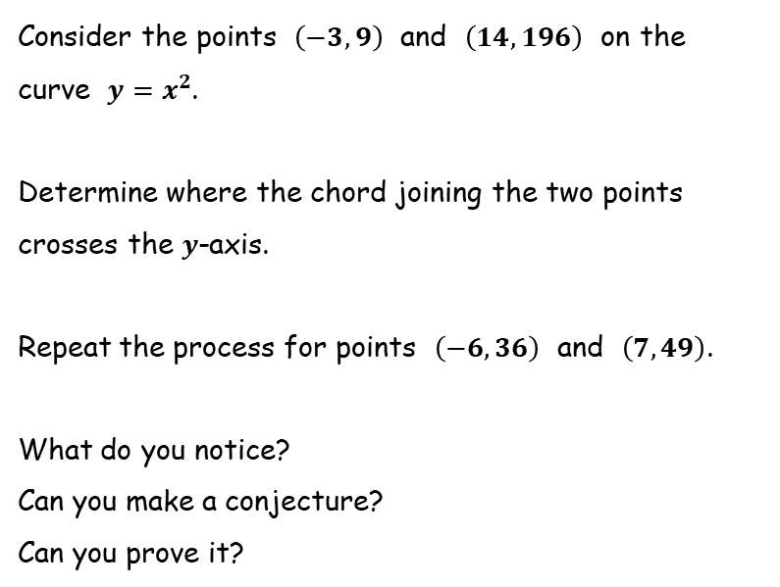
Y-Intercepts
SIC_89
$$y$$
$$y=x^{2}$$
Consider the points $\left(−3, 9\right)$ and $\left(14,196\right)$ on the curve $y=x^{2}$.
Determine where the chord joining the two points crosses the $y$-axis.
Repeat the process for points $\left(−6,36\right)$ and $\left(7,49\right)$.
What do you notice?
Can you make a conjecture?
Can you prove it?
$$x$$
$$y$$
$$y=x^{2}$$
$$x$$

Slide 17
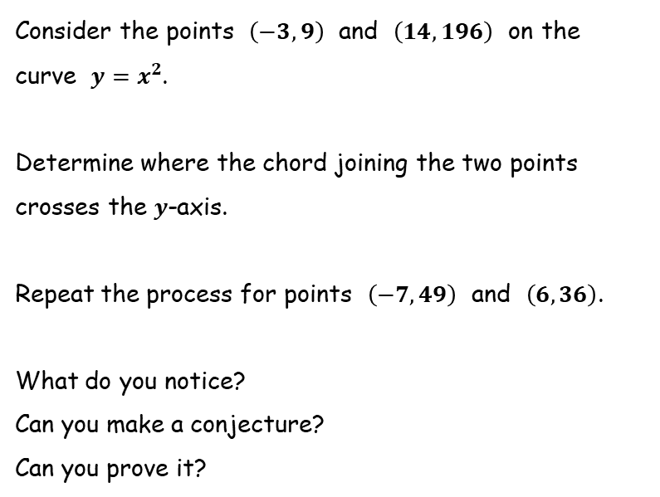
Y-Intercepts
SIC_89
$$y$$
$$y=x^{2}$$
Consider the points $\left(−3, 9\right)$ and $\left(14,196\right)$ on the curve $y=x^{2}$.
Determine where the chord joining the two points crosses the $y$-axis.
Repeat the process for points $\left(−7,49\right)$ and $\left(6,36\right)$.
What do you notice?
Can you make a conjecture?
Can you prove it?
$$x$$
$$y$$
$$y=x^{2}$$
$$x$$

Slide 18
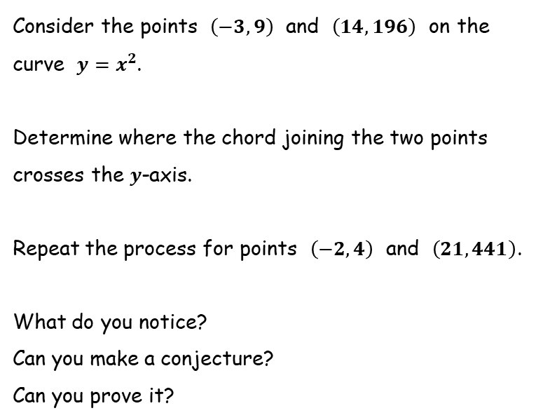
Y-Intercepts
SIC_89
$$y$$
$$y=x^{2}$$
Consider the points $\left(−3, 9\right)$ and $\left(14,196\right)$ on the curve $y=x^{2}$.
Determine where the chord joining the two points crosses the $y$-axis.
Repeat the process for points $\left(−2,4\right)$ and $\left(21,441\right)$.
What do you notice?
Can you make a conjecture?
Can you prove it?
$$x$$
$$y$$
$$y=x^{2}$$
$$x$$

Slide 19
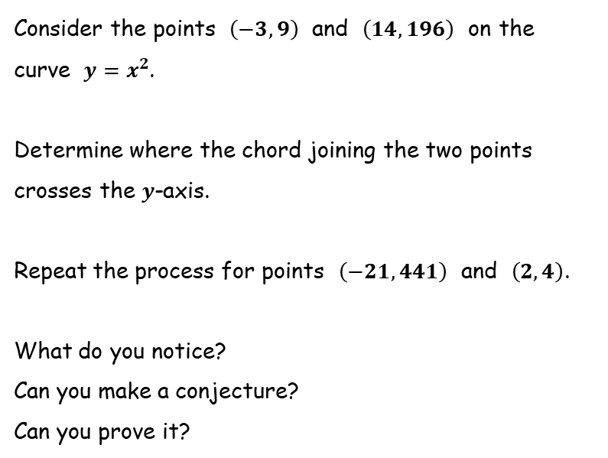
Y-Intercepts
SIC_89
$$y$$
$$y=x^{2}$$
Consider the points $\left(−3, 9\right)$ and $\left(14,196\right)$ on the curve $y=x^{2}$.
Determine where the chord joining the two points crosses the $y$-axis.
Repeat the process for points $\left(−21,441\right)$ and $\left(2,4\right)$.
What do you notice?
Can you make a conjecture?
Can you prove it?
$$x$$
$$y$$
$$y=x^{2}$$
$$x$$

Slide 20
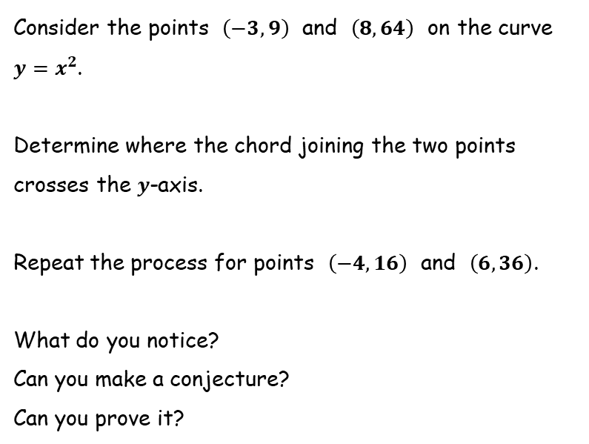
Y-Intercepts
SIC_89
$$y$$
$$y=x^{2}$$
Consider the points $\left(−3, 9\right)$ and $\left(8,64\right)$ on the curve $y=x^{2}$.
Determine where the chord joining the two points crosses the $y$-axis.
Repeat the process for points $\left(−4,16\right)$ and $\left(6,36\right)$.
What do you notice?
Can you make a conjecture?
Can you prove it?
$$x$$
$$y$$
$$y=x^{2}$$
$$x$$

Slide 21
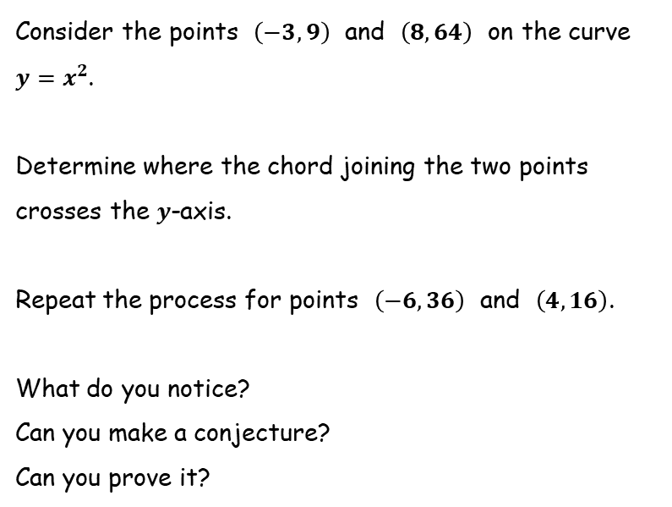
Y-Intercepts
SIC_89
$$y$$
$$y=x^{2}$$
Consider the points $\left(−3, 9\right)$ and $\left(8,64\right)$ on the curve $y=x^{2}$.
Determine where the chord joining the two points crosses the $y$-axis.
Repeat the process for points $\left(−6,36\right)$ and $\left(4,16\right)$.
What do you notice?
Can you make a conjecture?
Can you prove it?
$$x$$
$$y$$
$$y=x^{2}$$
$$x$$

Slide 22
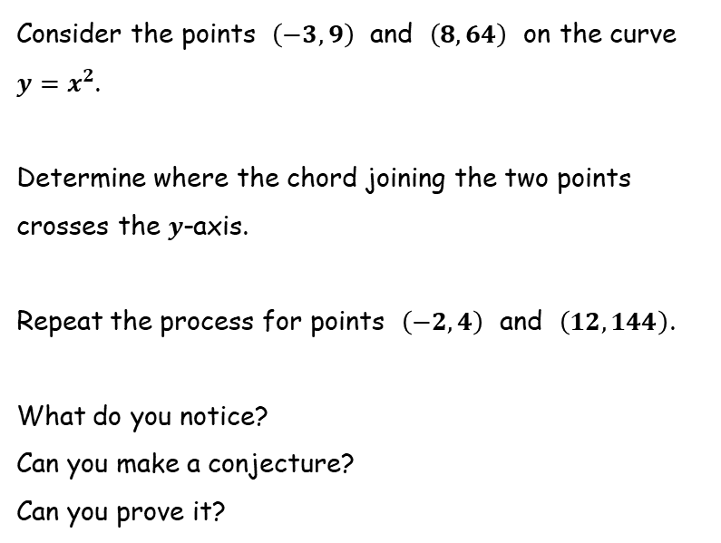
Y-Intercepts
SIC_89
$$y$$
$$y=x^{2}$$
Consider the points $\left(−3, 9\right)$ and $\left(8,64\right)$ on the curve $y=x^{2}$.
Determine where the chord joining the two points crosses the $y$-axis.
Repeat the process for points $\left(−2,4\right)$ and $\left(12,144\right)$.
What do you notice?
Can you make a conjecture?
Can you prove it?
$$x$$
$$y$$
$$y=x^{2}$$
$$x$$

Slide 23
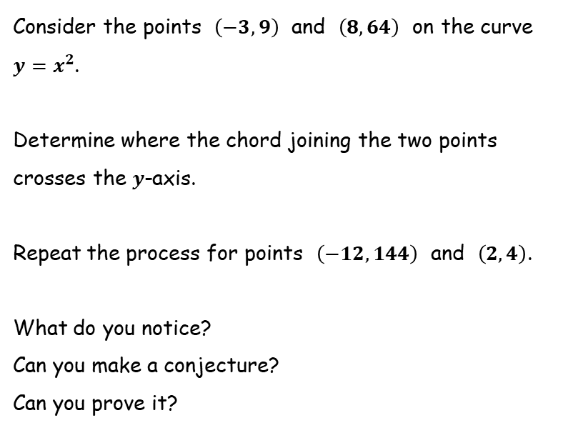
Y-Intercepts
SIC_89
$$y$$
$$y=x^{2}$$
Consider the points $\left(−3, 9\right)$ and $\left(8,64\right)$ on the curve $y=x^{2}$.
Determine where the chord joining the two points crosses the $y$-axis.
Repeat the process for points $\left(−12,144\right)$ and $\left(2,4\right)$.
What do you notice?
Can you make a conjecture?
Can you prove it?
$$x$$
$$y$$
$$y=x^{2}$$
$$x$$

Slide 24
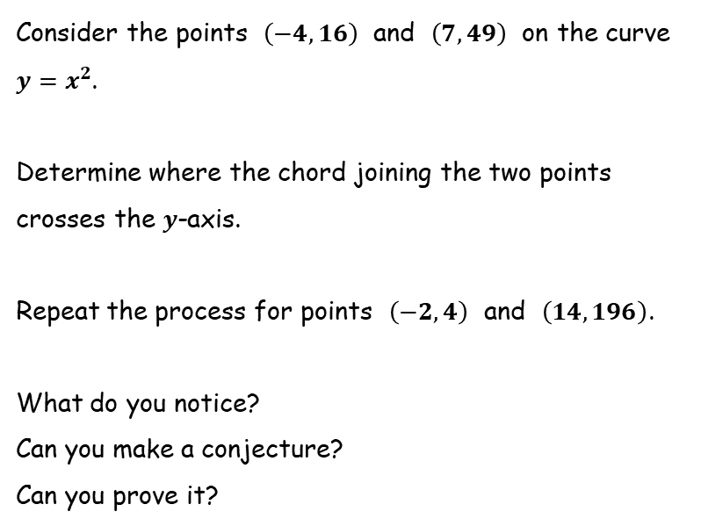
Y-Intercepts
SIC_89
$$y$$
$$y=x^{2}$$
Consider the points $\left(−4,16\right)$ and $\left(7,49\right)$ on the curve $y=x^{2}$.
Determine where the chord joining the two points crosses the $y$-axis.
Repeat the process for points $\left(−2,4\right)$ and $\left(14,196\right)$.
What do you notice?
Can you make a conjecture?
Can you prove it?
$$x$$
$$y$$
$$y=x^{2}$$
$$x$$

Slide 25
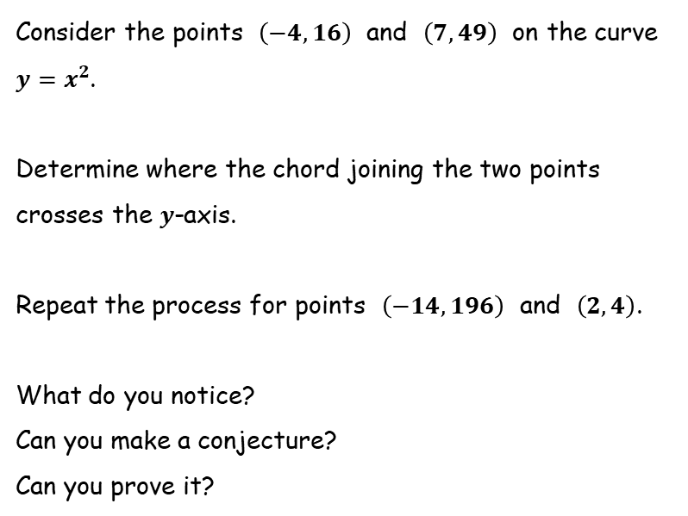
Y-Intercepts
SIC_89
$$y$$
$$y=x^{2}$$
Consider the points $\left(−4,16\right)$ and $\left(7,49\right)$ on the curve $y=x^{2}$.
Determine where the chord joining the two points crosses the $y$-axis.
Repeat the process for points $\left(−14,196\right)$ and $\left(2,4\right)$.
What do you notice?
Can you make a conjecture?
Can you prove it?
$$x$$
$$y$$
$$y=x^{2}$$
$$x$$

Slide 26
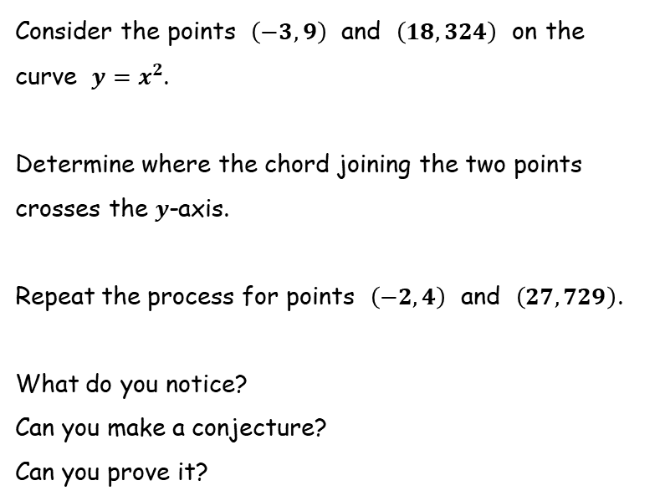
Y-Intercepts
SIC_89
$$y$$
$$y=x^{2}$$
Consider the points $\left(−3,9\right)$ and $\left(18,324\right)$ on the curve $y=x^{2}$.
Determine where the chord joining the two points crosses the $y$-axis.
Repeat the process for points $\left(−2,4\right)$ and $\left(27,729\right)$.
What do you notice?
Can you make a conjecture?
Can you prove it?
$$x$$
$$y$$
$$y=x^{2}$$
$$x$$

Slide 27
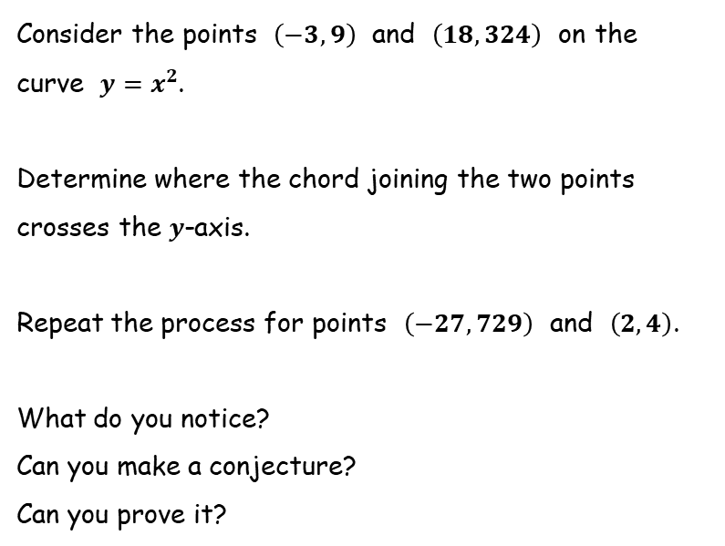
Y-Intercepts
SIC_89
$$y$$
$$y=x^{2}$$
Consider the points $\left(−3,9\right)$ and $\left(18,324\right)$ on the curve $y=x^{2}$.
Determine where the chord joining the two points crosses the $y$-axis.
Repeat the process for points $\left(−27,729\right)$ and $\left(2,4\right)$.
What do you notice?
Can you make a conjecture?
Can you prove it?
$$x$$
$$y$$
$$y=x^{2}$$
$$x$$

Slide 28
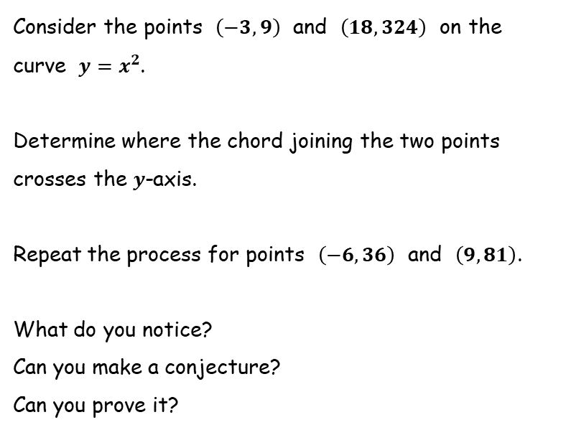
Y-Intercepts
SIC_89
$$y$$
$$y=x^{2}$$
Consider the points $\left(−3,9\right)$ and $\left(18,324\right)$ on the curve $y=x^{2}$.
Determine where the chord joining the two points crosses the $y$-axis.
Repeat the process for points $\left(−6,36\right)$ and $\left(9,81\right)$.
What do you notice?
Can you make a conjecture?
Can you prove it?
$$x$$
$$y$$
$$y=x^{2}$$
$$x$$

Slide 29
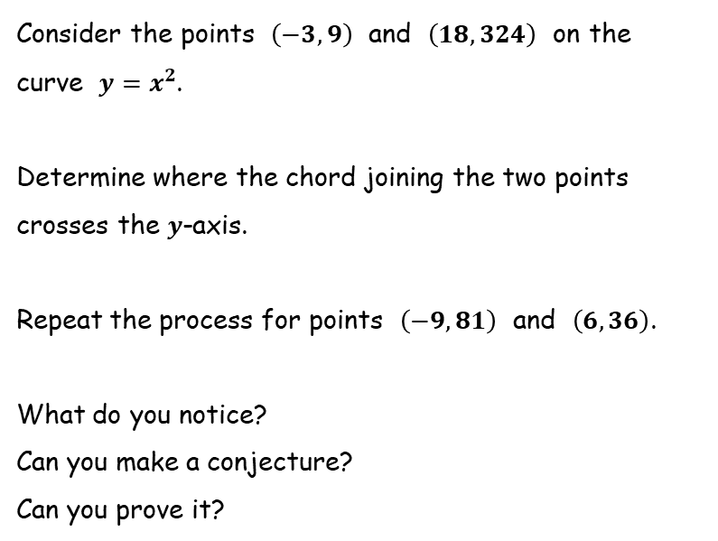
Y-Intercepts
SIC_89
$$y$$
$$y=x^{2}$$
Consider the points $\left(−3,9\right)$ and $\left(18,324\right)$ on the curve $y=x^{2}$.
Determine where the chord joining the two points crosses the $y$-axis.
Repeat the process for points $\left(−9,81\right)$ and $\left(6,36\right)$.
What do you notice?
Can you make a conjecture?
Can you prove it?
$$x$$
$$y$$
$$y=x^{2}$$
$$x$$

Slide 30
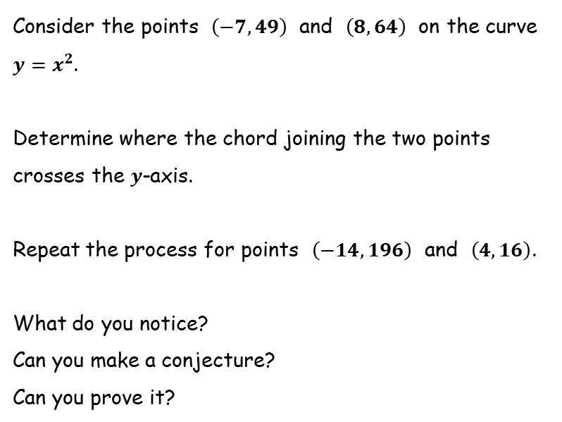
Y-Intercepts
SIC_89
$$y$$
$$y=x^{2}$$
Consider the points $\left(−7,49\right)$ and $\left(8,64\right)$ on the curve $y=x^{2}$.
Determine where the chord joining the two points crosses the $y$-axis.
Repeat the process for points $\left(−14,196\right)$ and $\left(4,16\right)$.
What do you notice?
Can you make a conjecture?
Can you prove it?
$$x$$
$$y$$
$$y=x^{2}$$
$$x$$

Slide 31
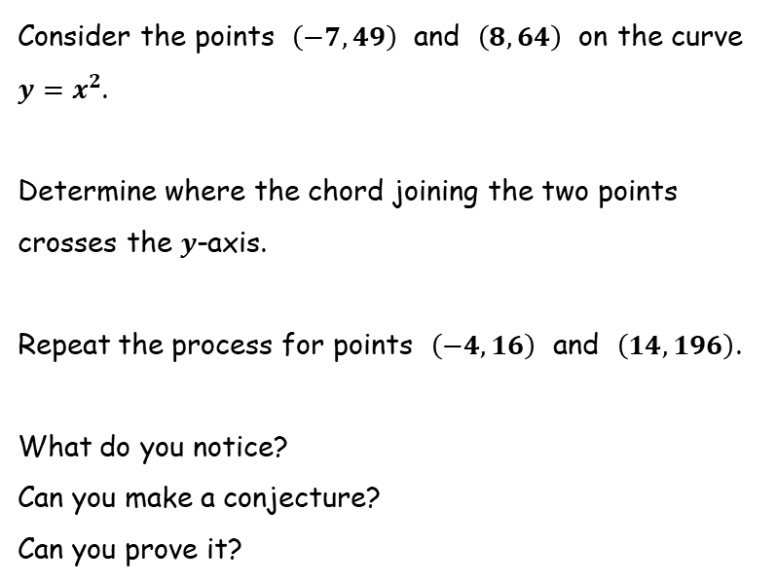
Y-Intercepts
SIC_89
$$y$$
$$y=x^{2}$$
Consider the points $\left(−7,49\right)$ and $\left(8,64\right)$ on the curve $y=x^{2}$.
Determine where the chord joining the two points crosses the $y$-axis.
Repeat the process for points $\left(−4,16\right)$ and $\left(14,196\right)$.
What do you notice?
Can you make a conjecture?
Can you prove it?
$$x$$
$$y$$
$$y=x^{2}$$
$$x$$

